Slide 1
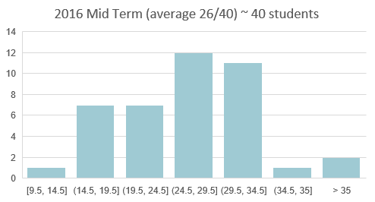
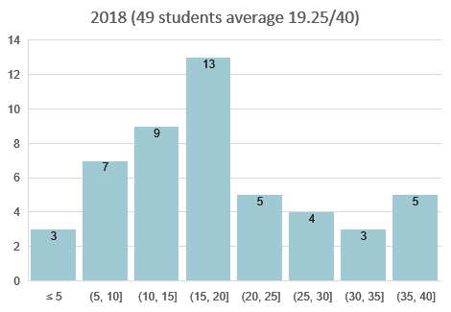
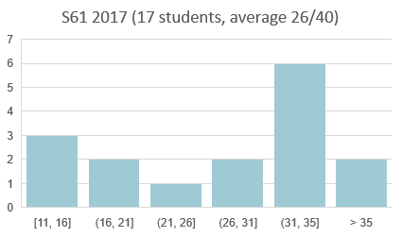
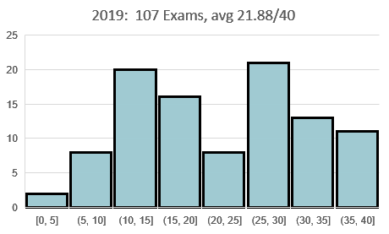
Mid Term Stuff

Slide 2
Chapter 4
The Processor

Slide 3
Introduction
§4.1 Introduction
CPU performance factors
Instruction count
Determined by ISA and compiler
CPI and Cycle time
Determined by CPU hardware
We will examine two MIPS implementations
A simplified version
A more realistic pipelined version
Simple subset, shows most aspects
Memory reference: lw, sw
Arithmetic/logical: add, sub, and, or, slt
Control transfer: beq, j

Slide 4
Instruction Execution
PC → instruction memory, fetch instruction
Register numbers → register file, read registers
Depending on instruction class
Use ALU to calculate
Arithmetic result
Memory address for load/store
Branch target address
Access data memory for load/store
PC ← target address or PC + 4

Slide 5
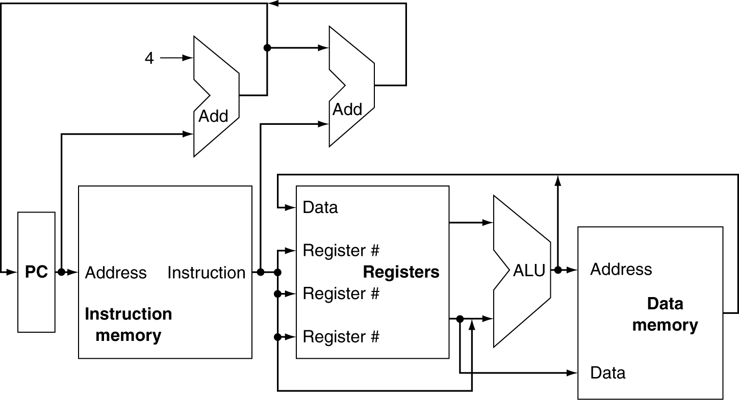
CPU Overview

Slide 6
Multiplexers
Can’t just join wires together
Use multiplexers
Notes:
A multiplexer joins inputs and has its own input lines to determine which inputs are used

Slide 7
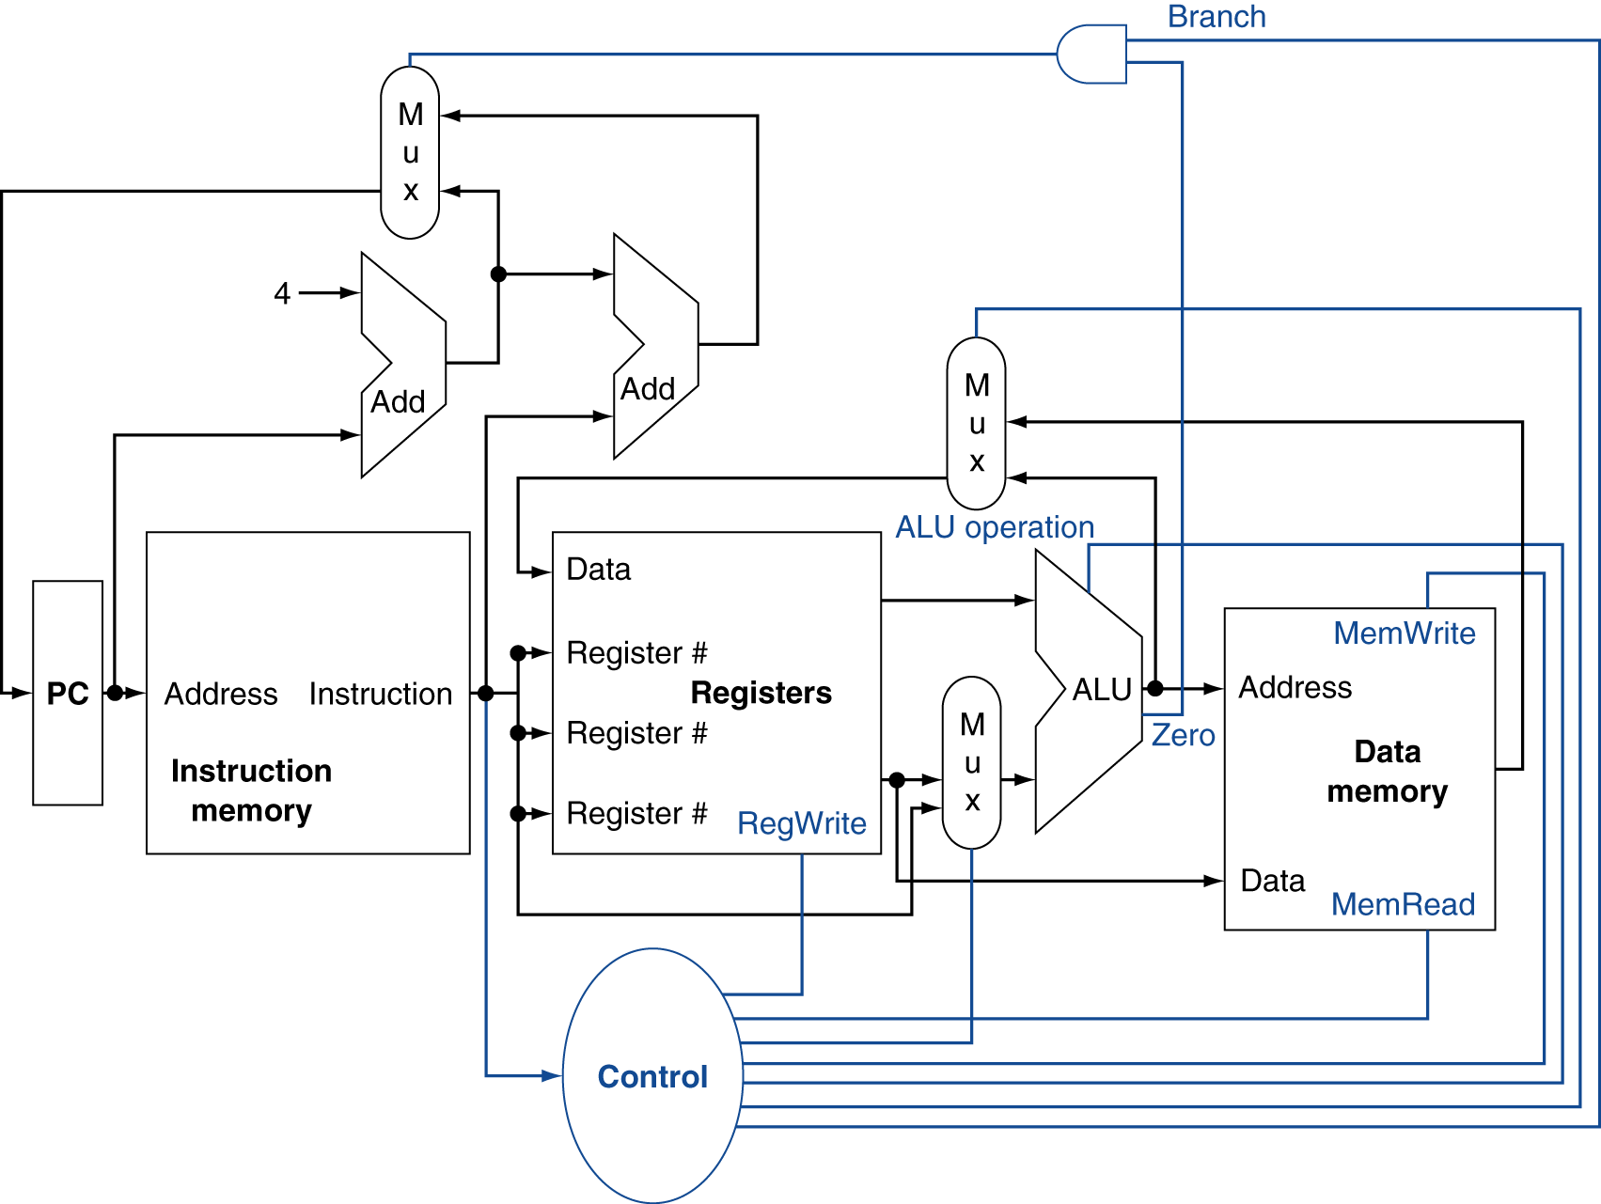
Control

Slide 8
Logic Design Basics
Information encoded in binary
Low voltage = 0, High voltage = 1
One wire per bit
Multi-bit data encoded on multi-wire buses
Combinational element
Operate on data
Output is a function of input
State (sequential) elements
Store information
§4.2 Logic Design Conventions

Slide 9
Combinational Elements
AND-gate
Y = A & B
Adder
Y = A + B
A
+
Y
B
A
Y
B
Arithmetic/Logic Unit
Y = F(A, B)
Multiplexer
Y = S ? I1 : I0
A
I0
M u x
Y
Y
ALU
I1
B
S
F

Slide 10
Sequential Elements
Register: stores data in a circuit
Uses a clock signal to determine when to update the stored value
Edge-triggered: update when Clk changes from 0 to 1
Clk
D
Q
D
Clk
Q

Slide 11
Sequential Elements
Register with write control
Only updates on clock edge when write control input is 1
Used when stored value is required later
Clk
D
Q
Write
Write
D
Clk
Q

Slide 12
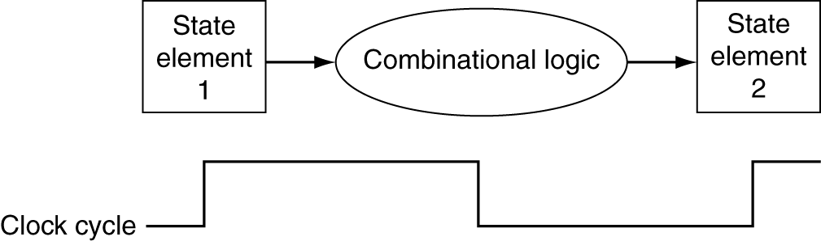
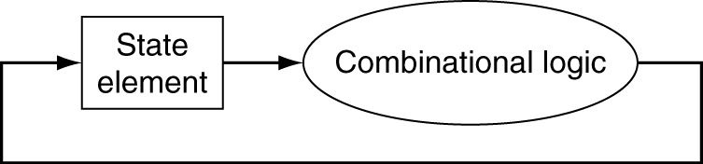
Clocking Methodology
Combinational logic transforms data during clock cycles
Between clock edges
Input from state elements, output to state element
Longest delay determines clock period

Slide 13
Building a Datapath
Datapath
Elements that process data and addresses in the CPU
Registers, ALUs, mux’s, memories, …
We will build a MIPS datapath incrementally
Refining the overview design
§4.3 Building a Datapath

Slide 14
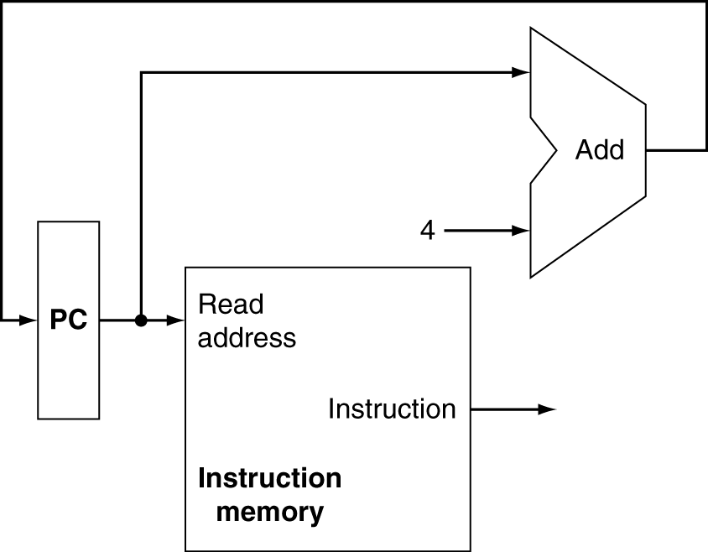
Instruction Fetch
Increment by 4 for next instruction
32-bit register

Slide 15
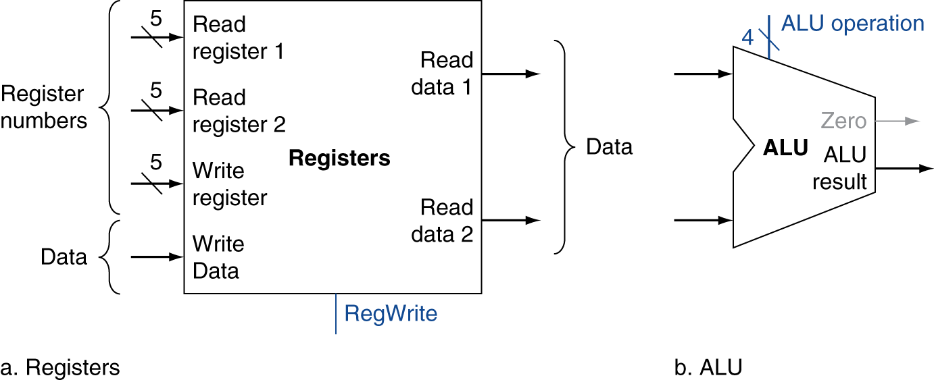
R-Format Instructions
Read two register operands
Perform arithmetic/logical operation
Write register result

Slide 16
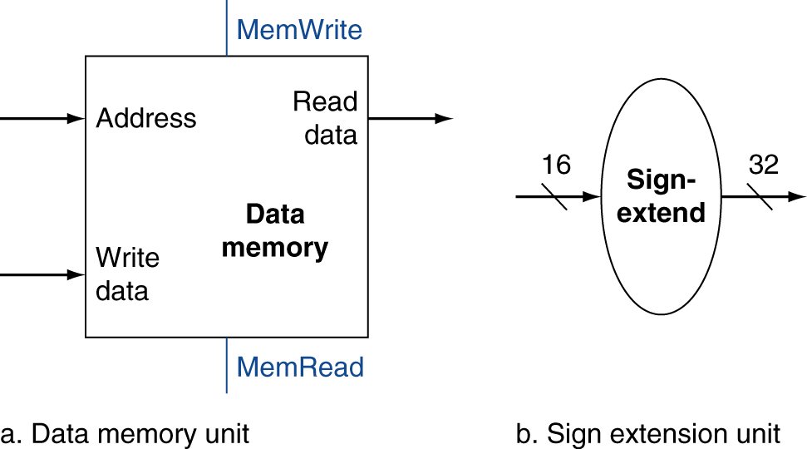
Load/Store Instructions
Read register operands
Calculate address using 16-bit offset
Use ALU, but sign-extend offset
Load: Read memory and update register
Store: Write register value to memory

Slide 17
Branch Instructions
Read register operands
Compare operands
Use ALU, subtract and check Zero output
Calculate target address
Sign-extend displacement
Shift left 2 places (word displacement)
Add to PC + 4
Already calculated by instruction fetch

Slide 18
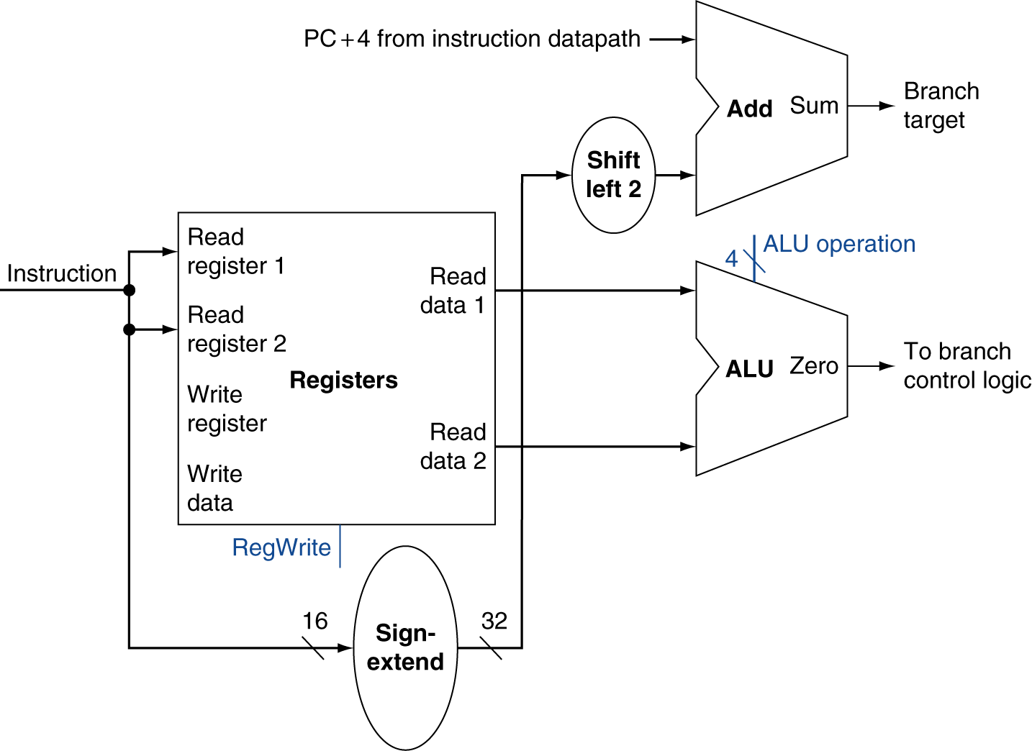
Branch Instructions
Just re-routes wires
Sign-bit wire replicated

Slide 19
Composing the Elements
First-cut data path does an instruction in one clock cycle
Each datapath element can only do one function at a time
Hence, we need separate instruction and data memories
Use multiplexers where alternate data sources are used for different instructions

Slide 20
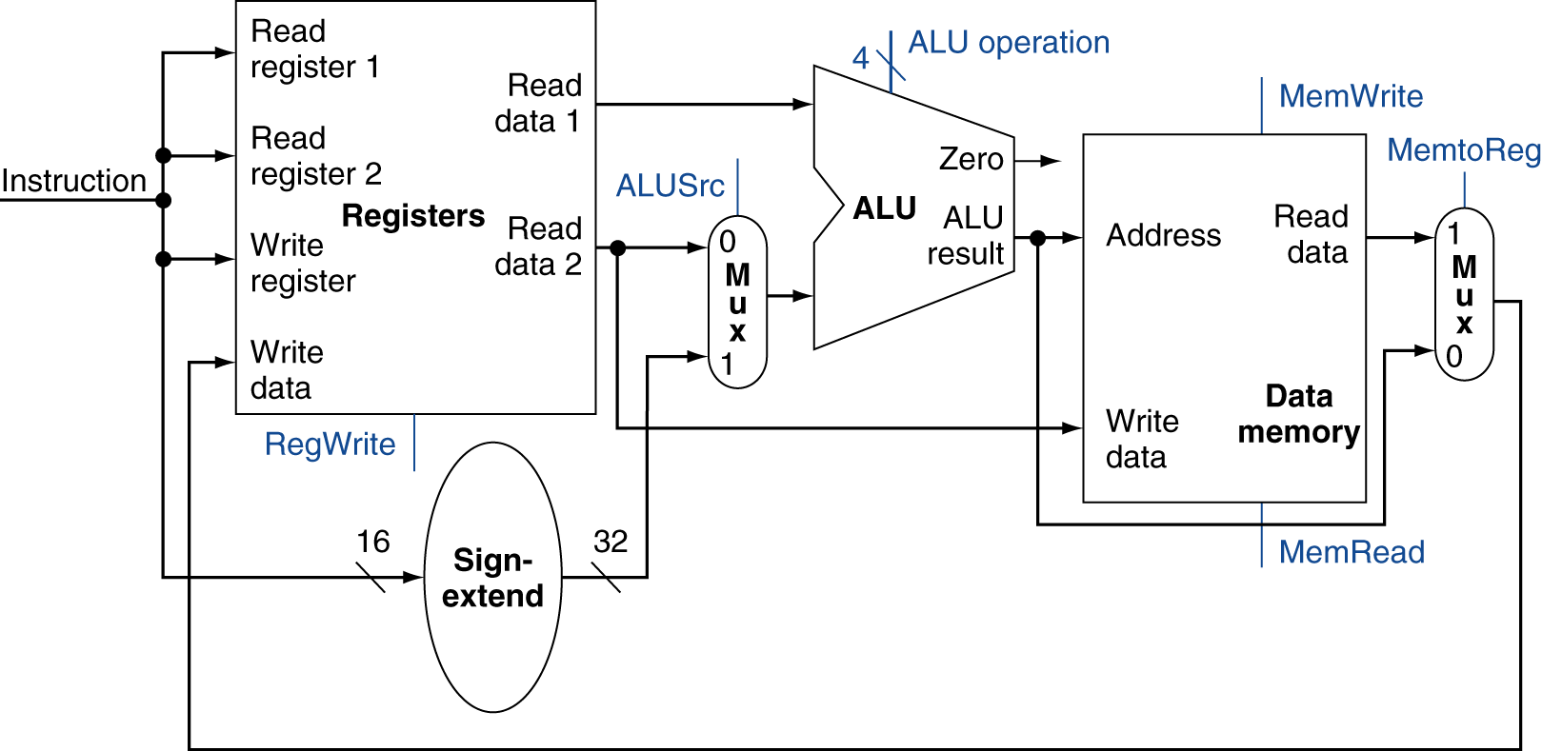
R-Type/Load/Store Datapath

Slide 21
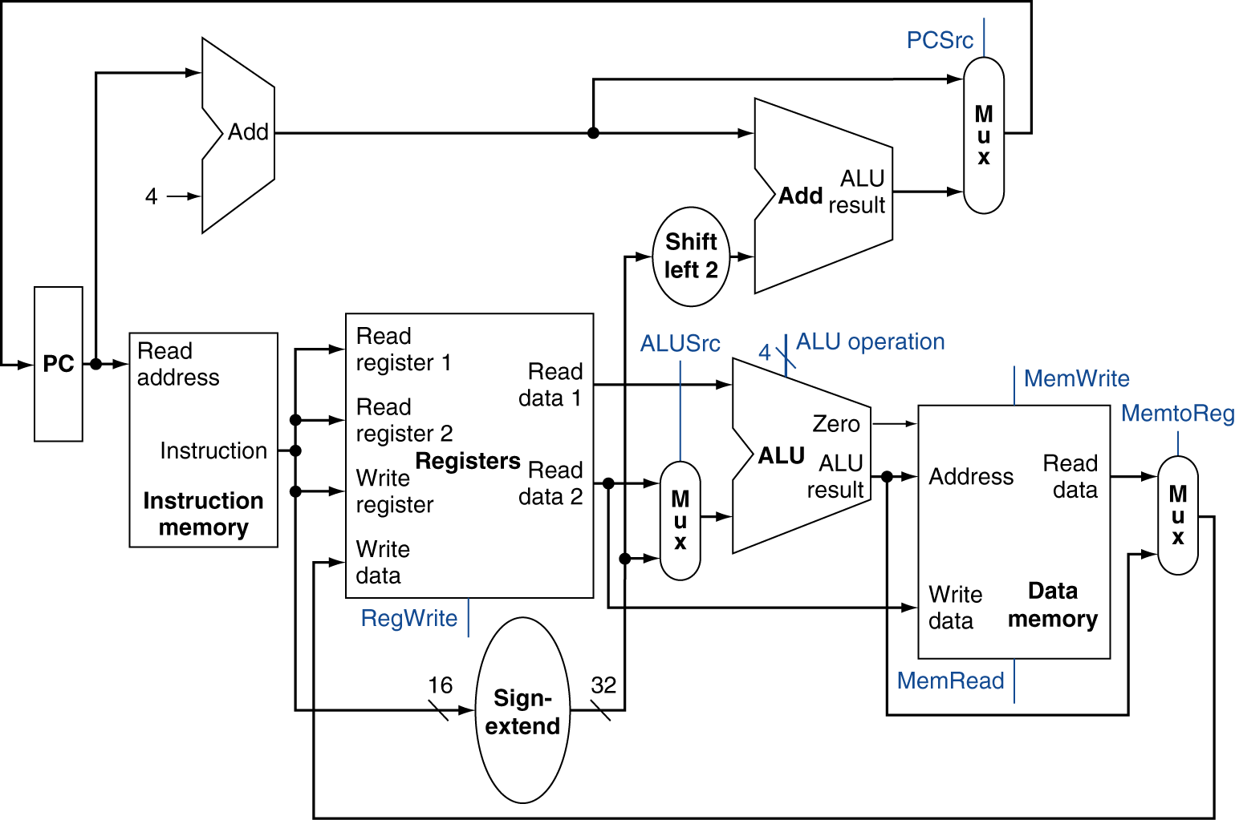
Full Datapath

Slide 22
ALU Control
ALU used for
Load/Store: F = add
Branch: F = subtract
R-type: F depends on funct field
§4.4 A Simple Implementation Scheme
ALU control | Function
0000 | AND
0001 | OR
0010 | add
0110 | subtract
0111 | set-on-less-than
1100 | NOR

Slide 23
ALU Control
Assume 2-bit ALUOp derived from opcode
Combinational logic derives ALU control
opcode | ALUOp | Operation | funct | ALU function | ALU control
lw | 00 | load word | XXXXXX | add | 0010
sw | 00 | store word | XXXXXX | add | 0010
beq | 01 | branch equal | XXXXXX | subtract | 0110
R-type | 10 | add | 100000 | add | 0010
 |  | subtract | 100010 | subtract | 0110
 |  | AND | 100100 | AND | 0000
 |  | OR | 100101 | OR | 0001
 |  | set-on-less-than | 101010 | set-on-less-than | 0111

Slide 24
The Main Control Unit
Control signals derived from instruction
R-type
0
rs
rt
rd
shamt
funct
31:26
25:21
20:16
15:11
10:6
5:0
Load/ Store
35 or 43
rs
rt
address
31:26
25:21
20:16
15:0
Branch
4
rs
rt
address
31:26
25:21
20:16
15:0
opcode
always read
read, except for load
write for R-type and load
sign-extend and add

Slide 25
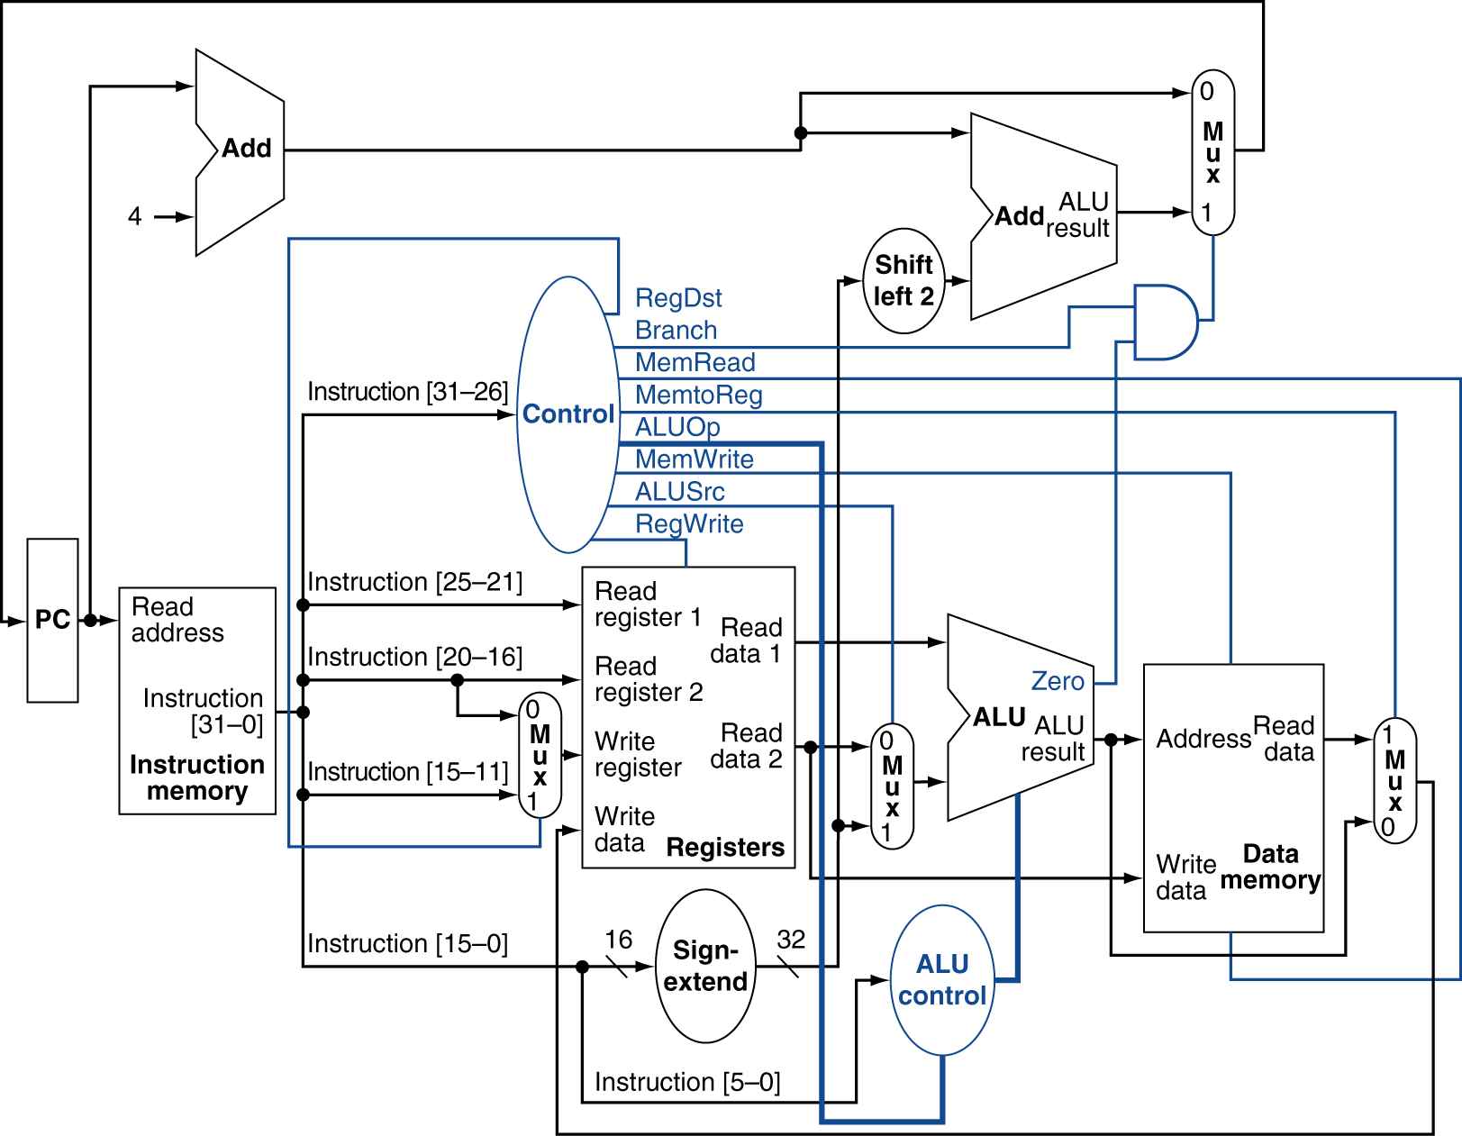
Datapath With Control

Slide 26
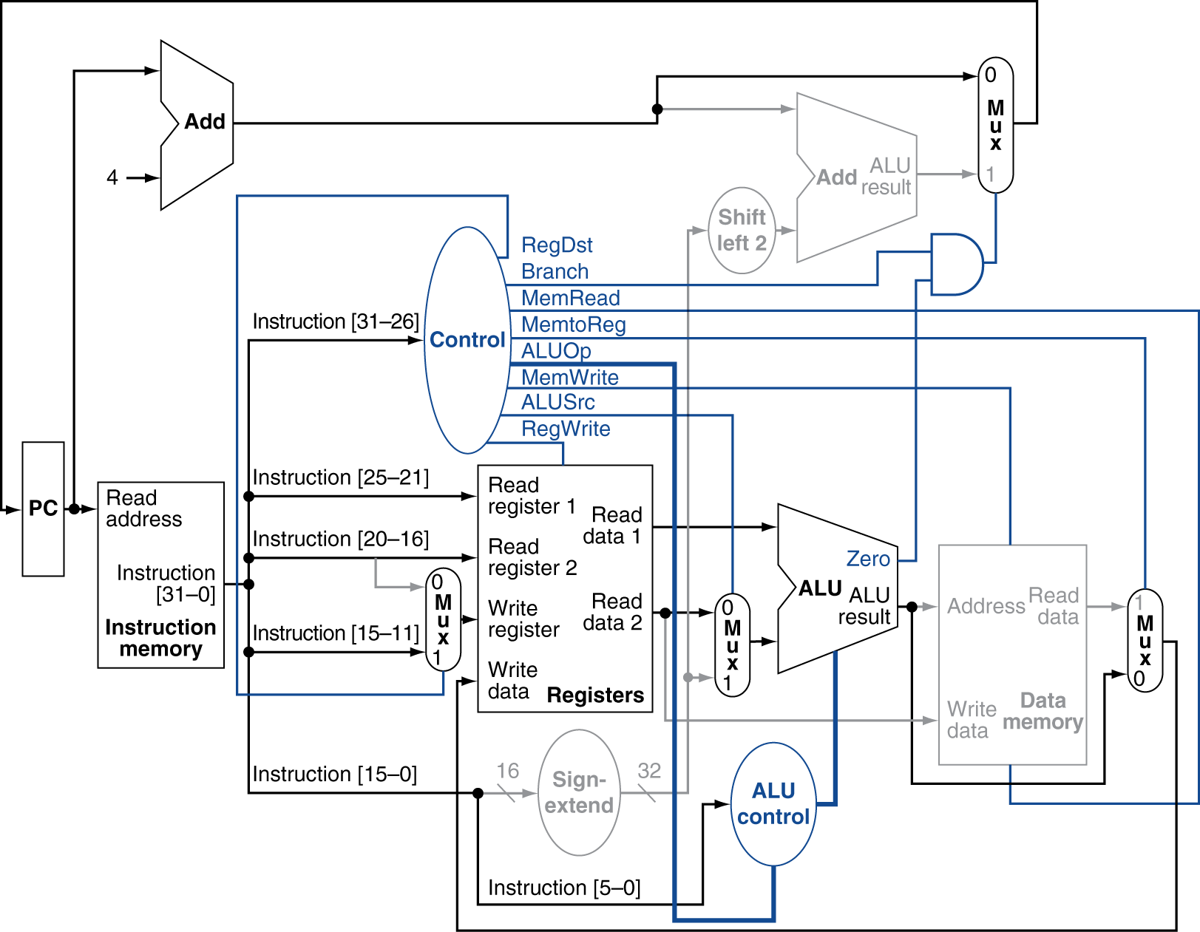
R-Type Instruction

Slide 27
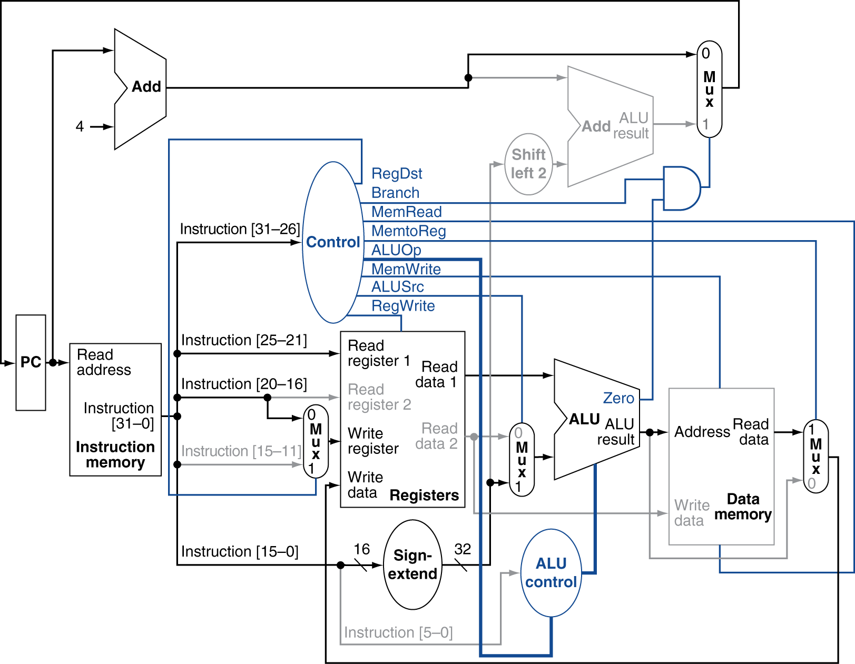
Load Instruction

Slide 28
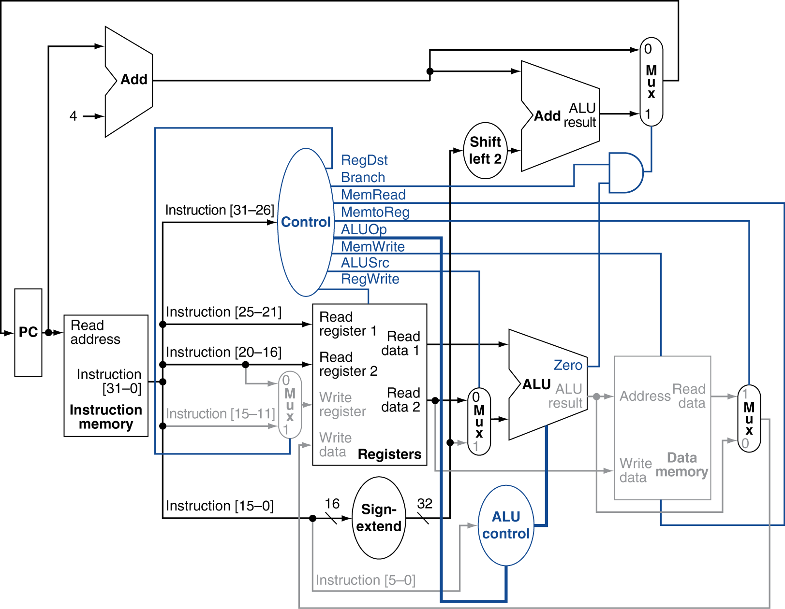
Branch-on-Equal Instruction

Slide 29
Implementing Jumps
Jump
2
address
31:26
25:0
Jump uses word address
Update PC with concatenation of
Top 4 bits of old PC
26-bit jump address
00
Need an extra control signal decoded from opcode

Slide 30
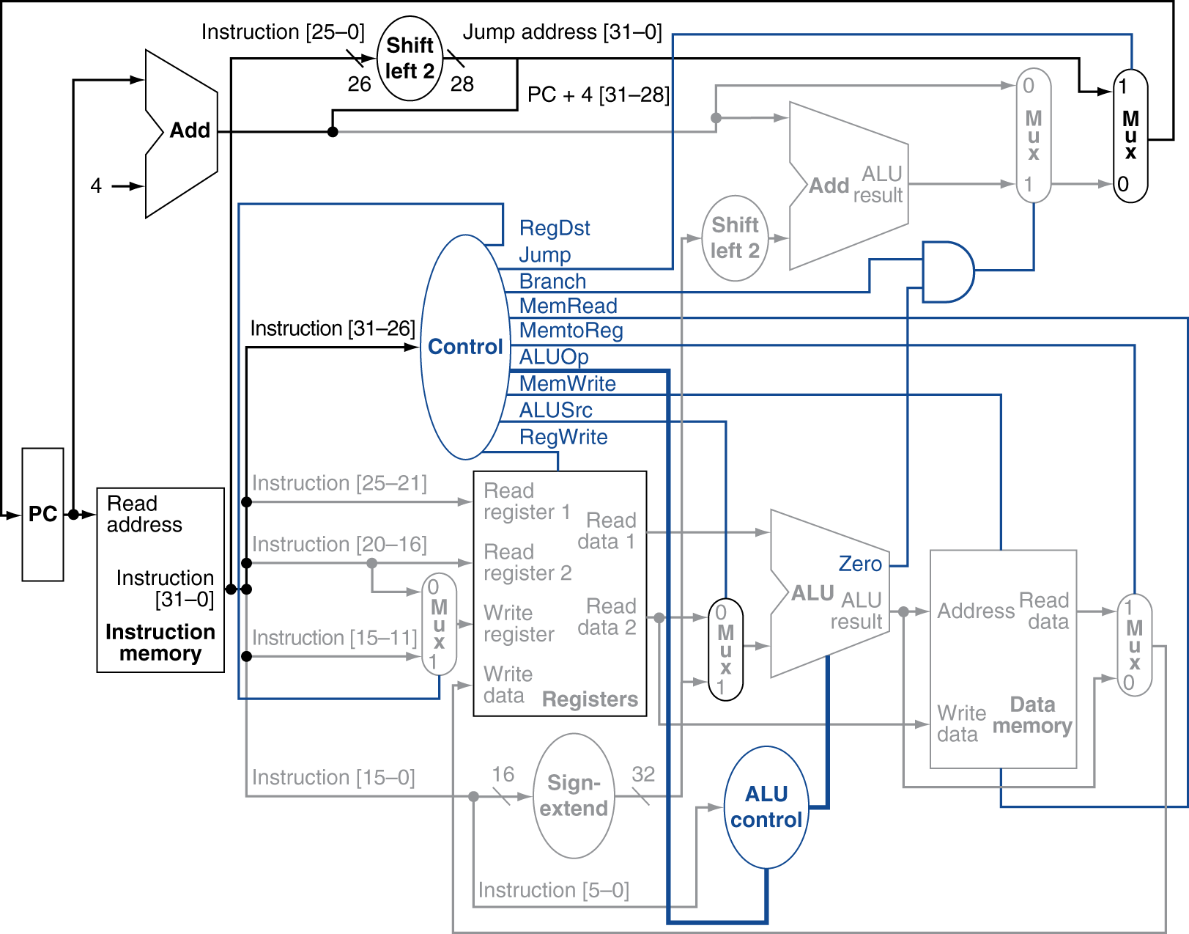
Datapath With Jumps Added

Slide 31
Performance Issues
Longest delay determines clock period
Critical path: load instruction
Instruction memory → register file → ALU → data memory → register file
Not feasible to vary period for different instructions
Violates design principle
Making the common case fast
We will improve performance by pipelining
Notes:
Sri note here – we’ve cut a lot of the circuit diagrams, but the core concept is that to add support for all this stuff, means more circuits and wires, the longer the path the data takes, the more of a problem we have.

Slide 32
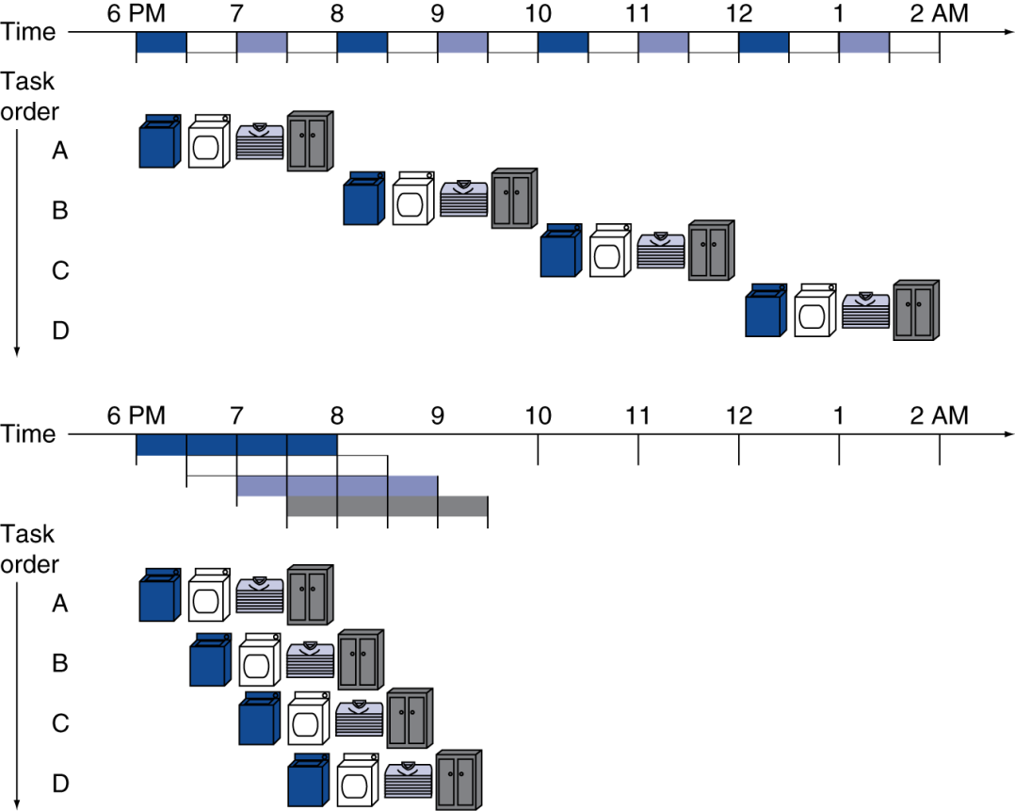
Pipelining Analogy
Pipelined laundry: overlapping execution
Parallelism improves performance
§4.5 An Overview of Pipelining
Four loads:
Speedup = 8/3.5 = 2.3
Non-stop:
Speedup = 2n/0.5n + 1.5 ≈ 4 = number of stages

Slide 33
X86 Pipeline
The original 8086 was a 4 step pipeline which we’ll talk about shortly – fetch, decode, execute, write
Conceptually pretty much all steps do just those four, but expand them
As time has gone on Intel has gone to a deep pipeline and superscalar – meaning multiple steps at once.
New processors have about 30 stages.
Notes:
Added by Sri source http://www.gamedev.net/page/resources/_/technical/general-programming/a-journey-through-the-cpu-pipeline-r3115

Slide 34
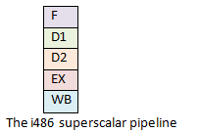
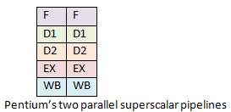
Notes:
http://www.gamedev.net/page/resources/_/technical/general-programming/a-journey-through-the-cpu-pipeline-r3115 D1 and D2 are Decode 1 and Decode 2 (think indirect addressing)

Slide 35
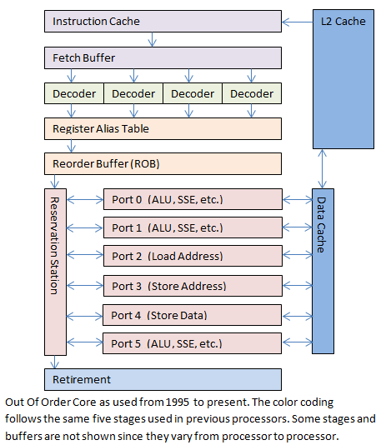

Slide 36
MIPS Pipeline
Five stages, one step per stage
IF: Instruction fetch from memory
ID: Instruction decode & register read
EX: Execute operation or calculate address
MEM: Access memory operand
WB: Write result back to register

Slide 37
Pipeline Performance
Assume time for stages is
100ps for register read or write
200ps for other stages
Compare pipelined datapath with single-cycle datapath
Instr | Instr fetch | Register read | ALU op | Memory access | Register write | Total time
lw | 200ps | 100 ps | 200ps | 200ps | 100 ps | 800ps
sw | 200ps | 100 ps | 200ps | 200ps |  | 700ps
R-format | 200ps | 100 ps | 200ps |  | 100 ps | 600ps
beq | 200ps | 100 ps | 200ps |  |  | 500ps

Slide 38
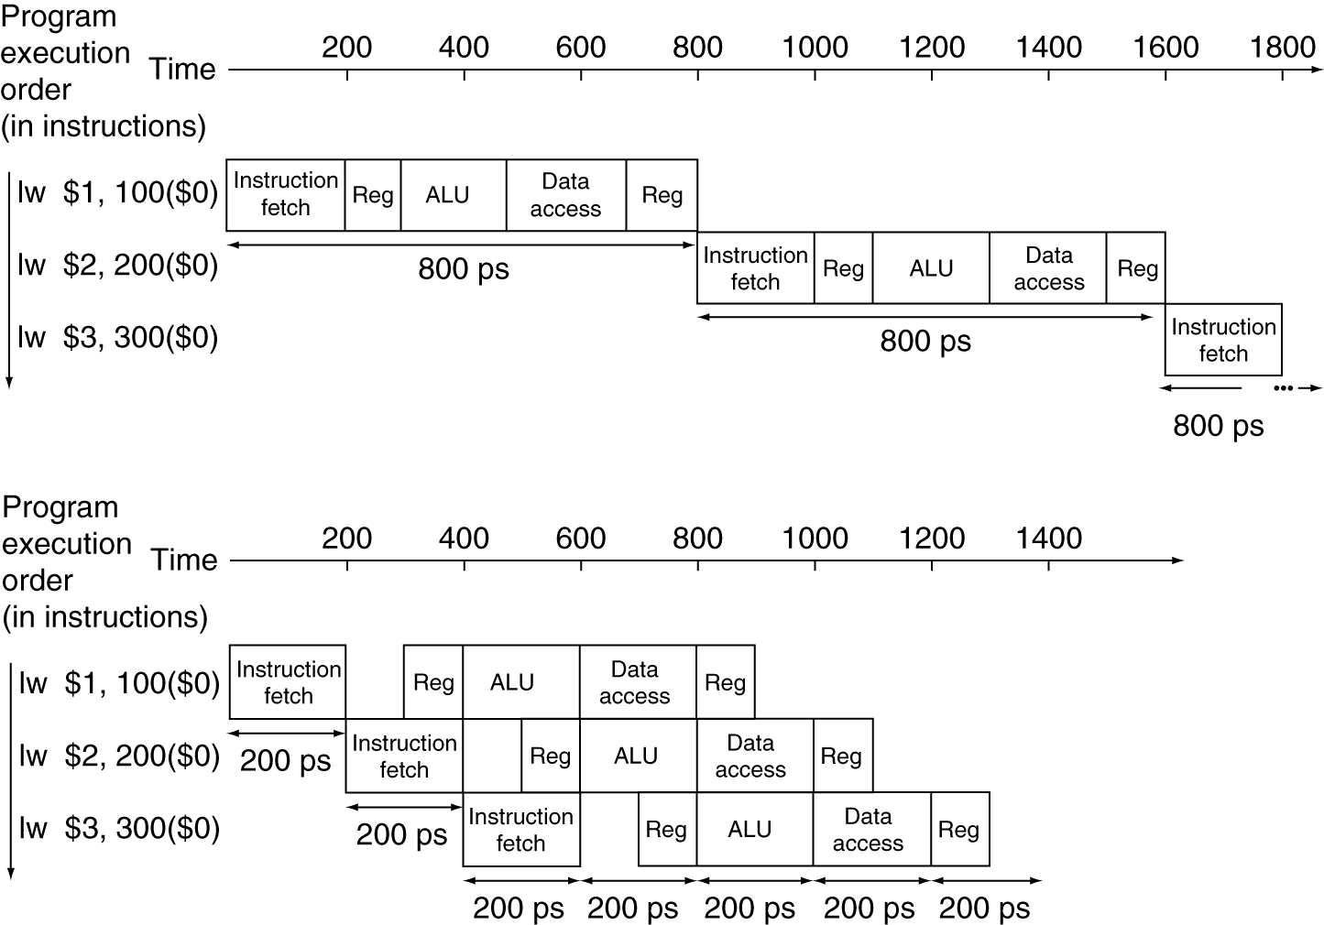
Pipeline Performance
Single-cycle (T_{c}= 800ps)
Pipelined (T_{c}= 200ps)

Slide 39
Pipeline Speedup
If all stages are balanced
i.e., all take the same time
Time between instructions_{pipelined} = Time between instructions_{nonpipelined} Number of stages
If not balanced, speedup is less
Speedup due to increased throughput
Latency (time for each instruction) does not decrease

Slide 40
Pipelining and ISA Design
MIPS ISA designed for pipelining
All instructions are 32-bits
Easier to fetch and decode in one cycle
c.f. x86: 1- to 17-byte instructions
Few and regular instruction formats
Can decode and read registers in one step
Load/store addressing
Can calculate address in 3rd stage, access memory in 4th stage
Alignment of memory operands
Memory access takes only one cycle

Slide 41
Practical Design - Sri
Part of the genius of Intel was realizing you could fetch and cache many instructions or many pieces of data at once
Fetching an instruction also takes a fairly fixed amount of time, and it’s short. Fetching data… not so much (depends where the data is, and many data reads are of random size, e.g. strings)

Slide 42
Adding Stages - Sri
By adding caches you could have things like SIMD (single instruction multiple data)
Or you could repeat only the units that slow you down (depends on load), e.g. Floating Point units
You could even start executing the next instruction before the last one finishes sometimes.

Slide 43
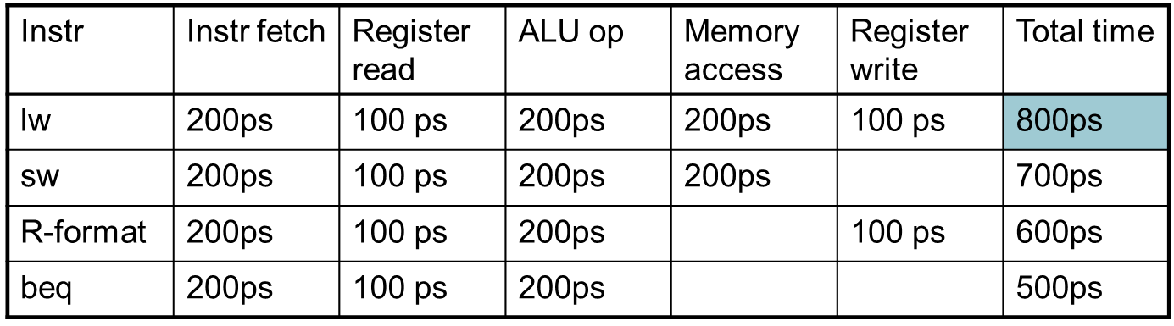
Emulating Other ISAs
With this chart from a couple of slides ago
(Chart of Instruction times)
If you want to duplicate an ISA somewhere else you need to be able to produce the same timings.
If you can’t, the emulated program won’t pipeline the same way

Slide 44
Hazards (Text, IMPORTANT)
Situations that prevent starting the next instruction in the next cycle
Structure hazards
A required resource is busy
Data hazard
Need to wait for previous instruction to complete its data read/write
Control hazard
Deciding on control action depends on previous instruction

Slide 45
Structure Hazards
Conflict for use of a resource
In MIPS pipeline with a single memory
Load/store requires data access
Instruction fetch would have to stall for that cycle
Would cause a pipeline “bubble”
Hence, pipelined datapaths require separate instruction/data memories
Or separate instruction/data caches

Slide 46
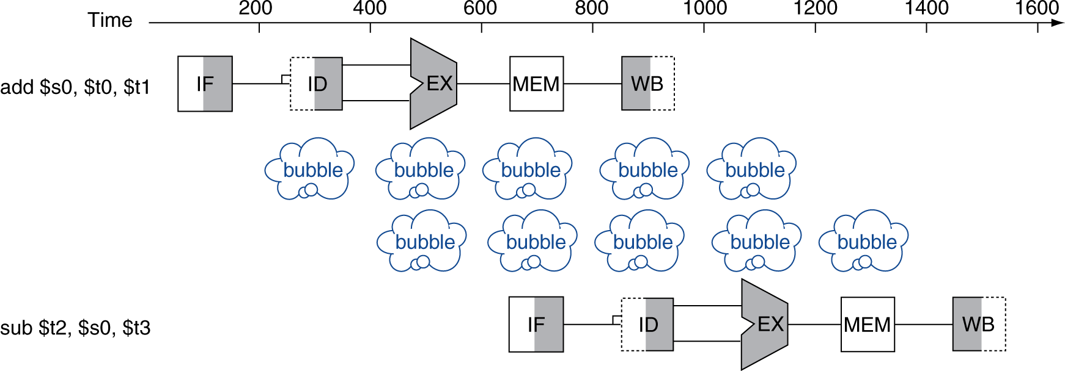
Data Hazards
An instruction depends on completion of data access by a previous instruction
add $s0, $t0, $t1 sub $t2, $s0, $t3

Slide 47
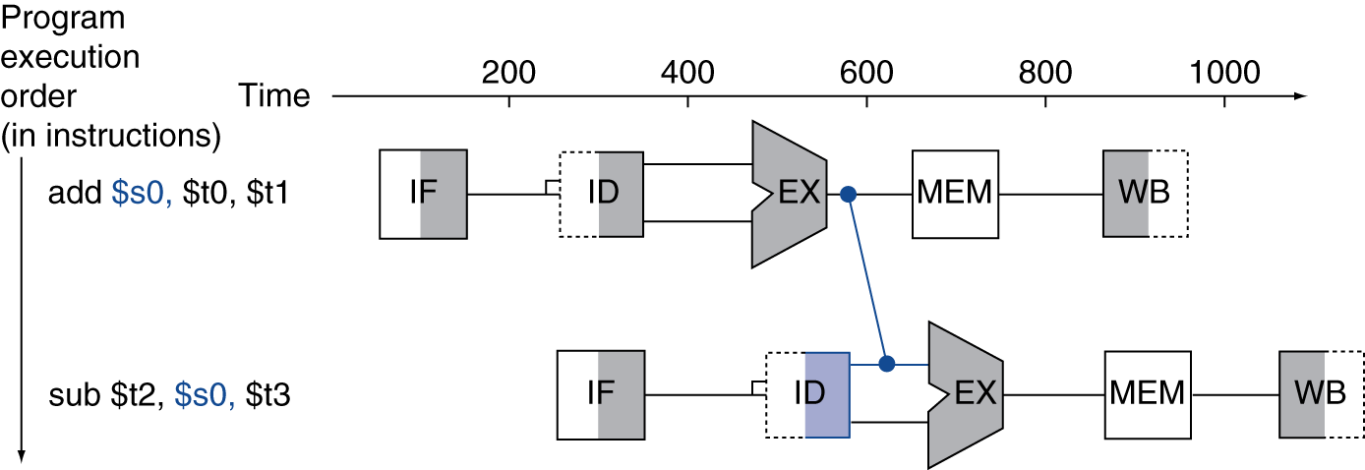
Forwarding (aka Bypassing)
Use result when it is computed
Don’t wait for it to be stored in a register
Requires extra connections in the datapath

Slide 48
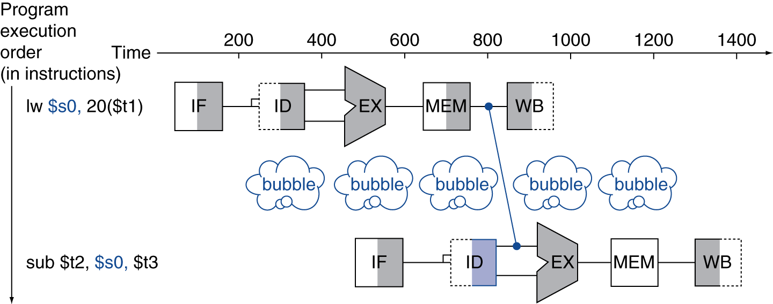
Load-Use Data Hazard
Can’t always avoid stalls by forwarding
If value not computed when needed
Can’t forward backward in time!

Slide 49
Code Scheduling to Avoid Stalls
Reorder code to avoid use of load result in the next instruction
C code for A = B + E; C = B + F;
lw $t1, 0($t0)
lw $t2, 4($t0)
add $t3, $t1, $t2
sw $t3, 12($t0)
lw $t4, 8($t0)
add $t5, $t1, $t4
sw $t5, 16($t0)
lw $t1, 0($t0)
lw $t2, 4($t0)
lw $t4, 8($t0)
add $t3, $t1, $t2
sw $t3, 12($t0)
add $t5, $t1, $t4
sw $t5, 16($t0)
stall
stall
13 cycles
11 cycles

Slide 50
Control Hazards
Branch determines flow of control
Fetching next instruction depends on branch outcome
Pipeline can’t always fetch correct instruction
Still working on ID stage of branch
In MIPS pipeline
Need to compare registers and compute target early in the pipeline
Add hardware to do it in ID stage

Slide 51
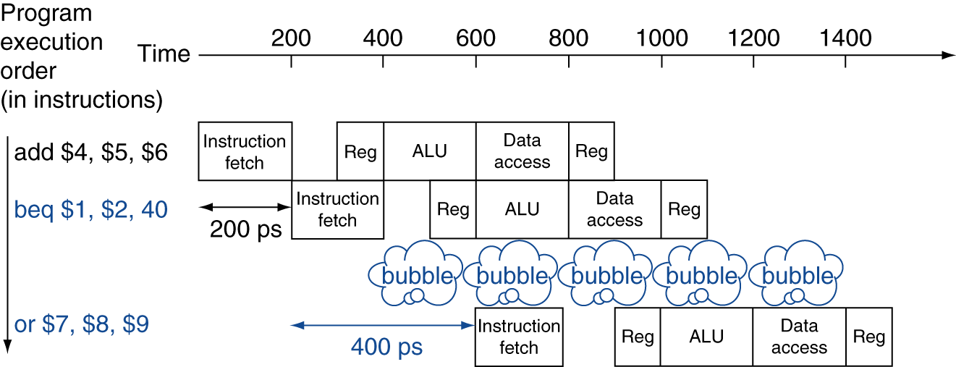
Stall on Branch
Wait until branch outcome determined before fetching next instruction

Slide 52
Branch Prediction
Longer pipelines can’t readily determine branch outcome early
Stall penalty becomes unacceptable
Predict outcome of branch
Only stall if prediction is wrong
In MIPS pipeline
Can predict branches not taken
Fetch instruction after branch, with no delay

Slide 53
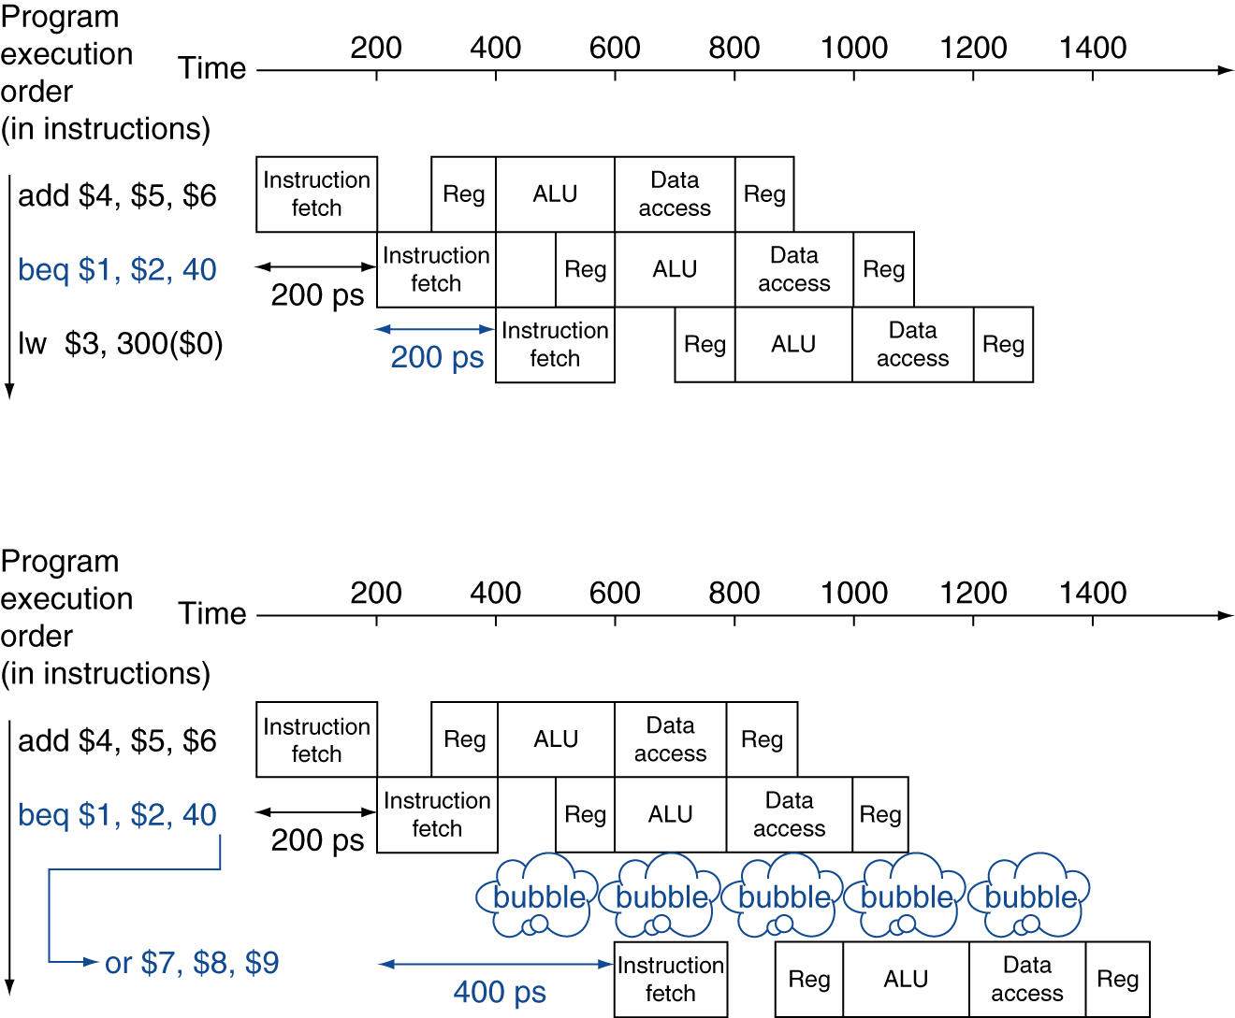
MIPS with Predict Not Taken
Prediction correct
Prediction incorrect

Slide 54
More-Realistic Branch Prediction
Static branch prediction
Based on typical branch behavior
Example: loop and if-statement branches
Predict backward branches taken
Predict forward branches not taken
Dynamic branch prediction
Hardware measures actual branch behavior
e.g., record recent history of each branch
Assume future behavior will continue the trend
When wrong, stall while re-fetching, and update history

Slide 55
Pipeline Summary
The BIG Picture
Pipelining improves performance by increasing instruction throughput
Executes multiple instructions in parallel
Each instruction has the same latency
Subject to hazards
Structure, data, control
Instruction set design affects complexity of pipeline implementation

Slide 56
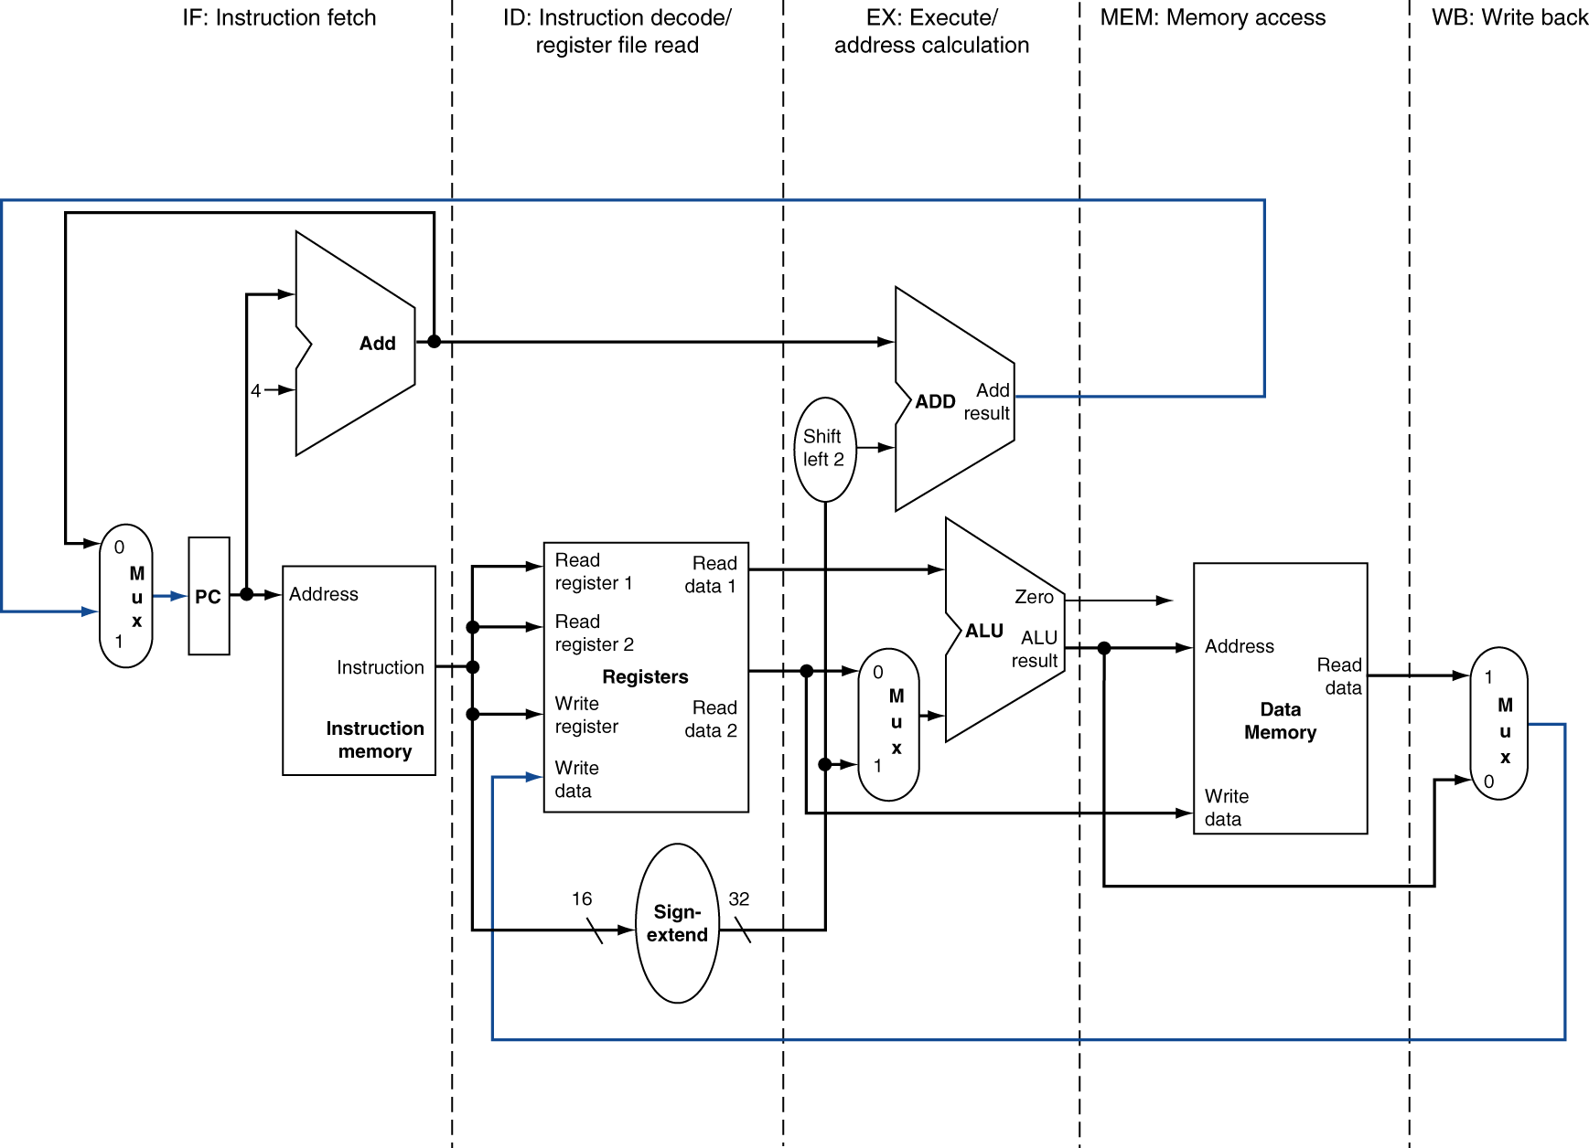
MIPS Pipelined Datapath
§4.6 Pipelined Datapath and Control
MEM
Right-to-left flow leads to hazards
WB

Slide 57
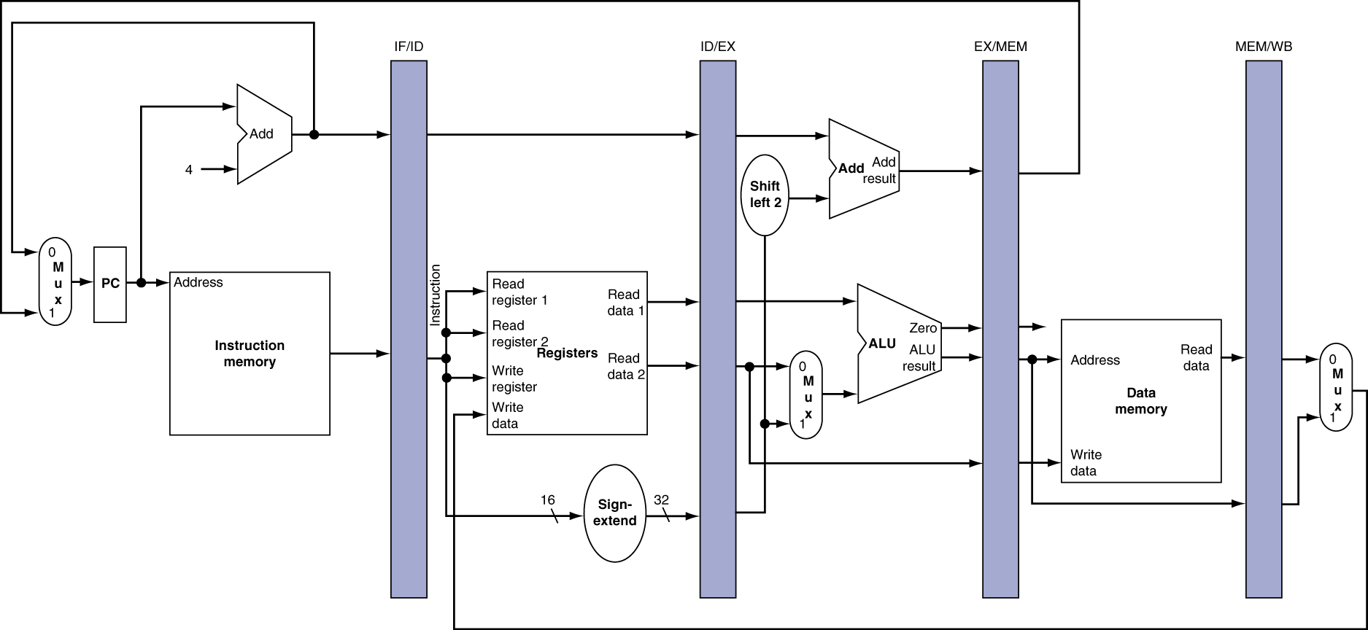
Pipeline registers
Need registers between stages
To hold information produced in previous cycle

Slide 58
Pipeline Operation
Cycle-by-cycle flow of instructions through the pipelined datapath
“Single-clock-cycle” pipeline diagram
Shows pipeline usage in a single cycle
Highlight resources used
c.f. “multi-clock-cycle” diagram
Graph of operation over time
We’ll look at “single-clock-cycle” diagrams for load & store

Slide 59
Sri note, don’t try and really understand the next series of hardware diagrams
I’ll walk through it in class but you don’t need to know how to design or implement any of it
Pick back up at the multi-cycle CPU stuff

Slide 60
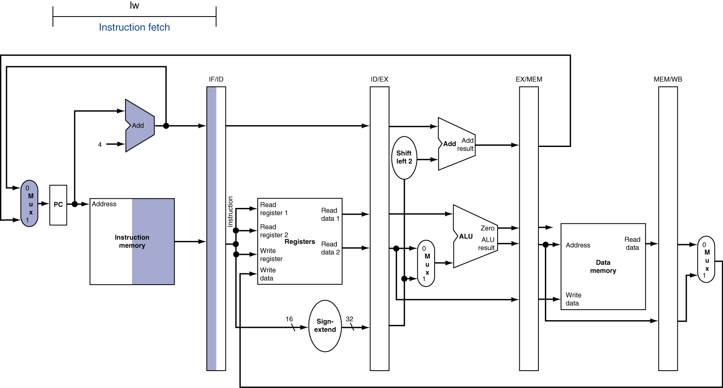
IF for Load, Store, …

Slide 61
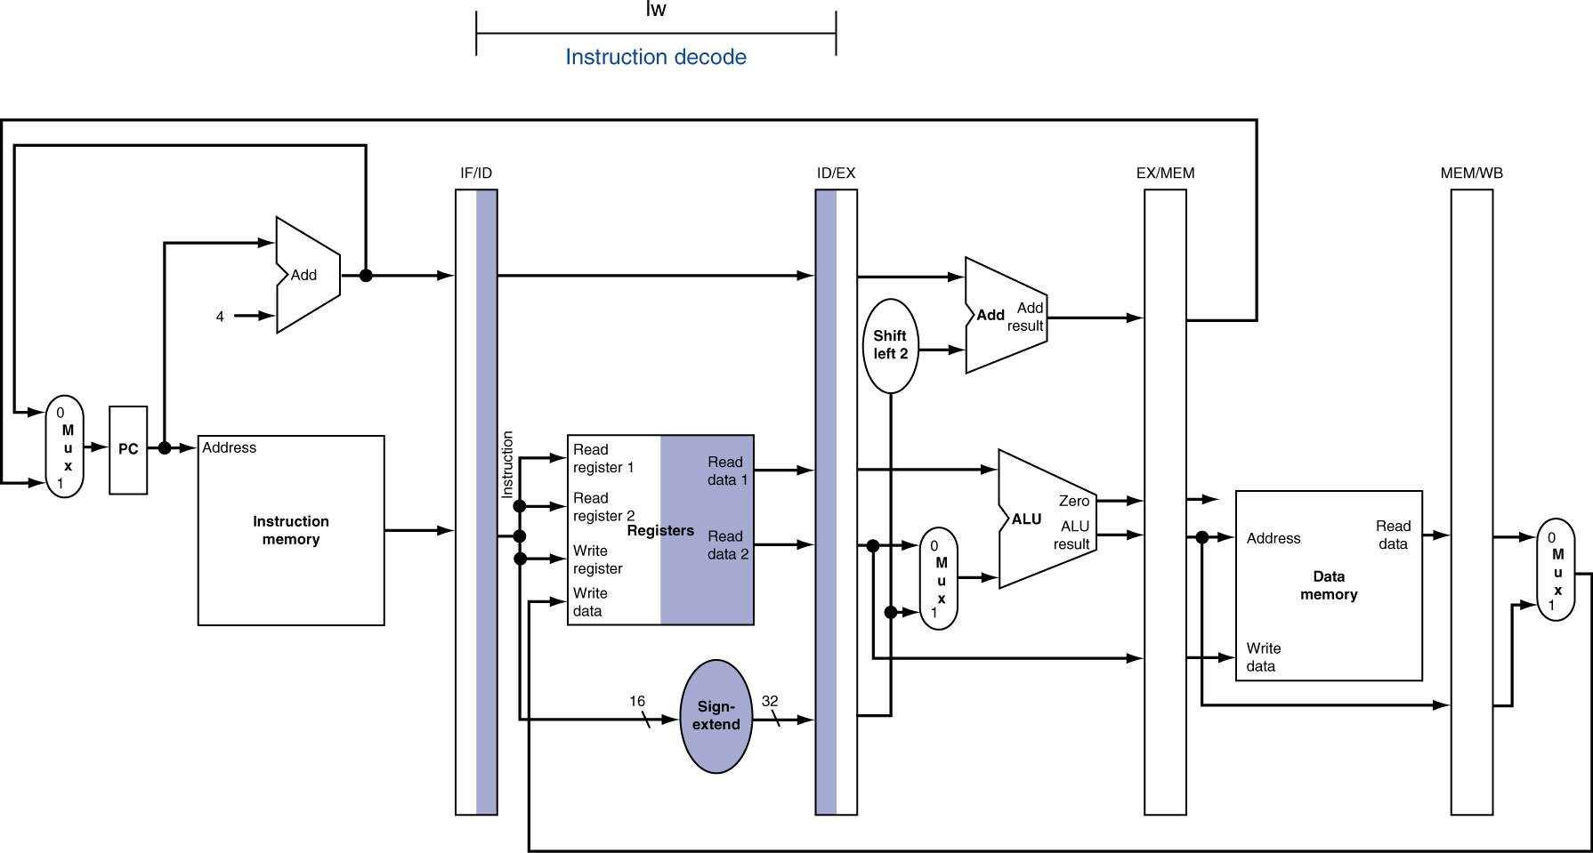
ID for Load, Store, …

Slide 62
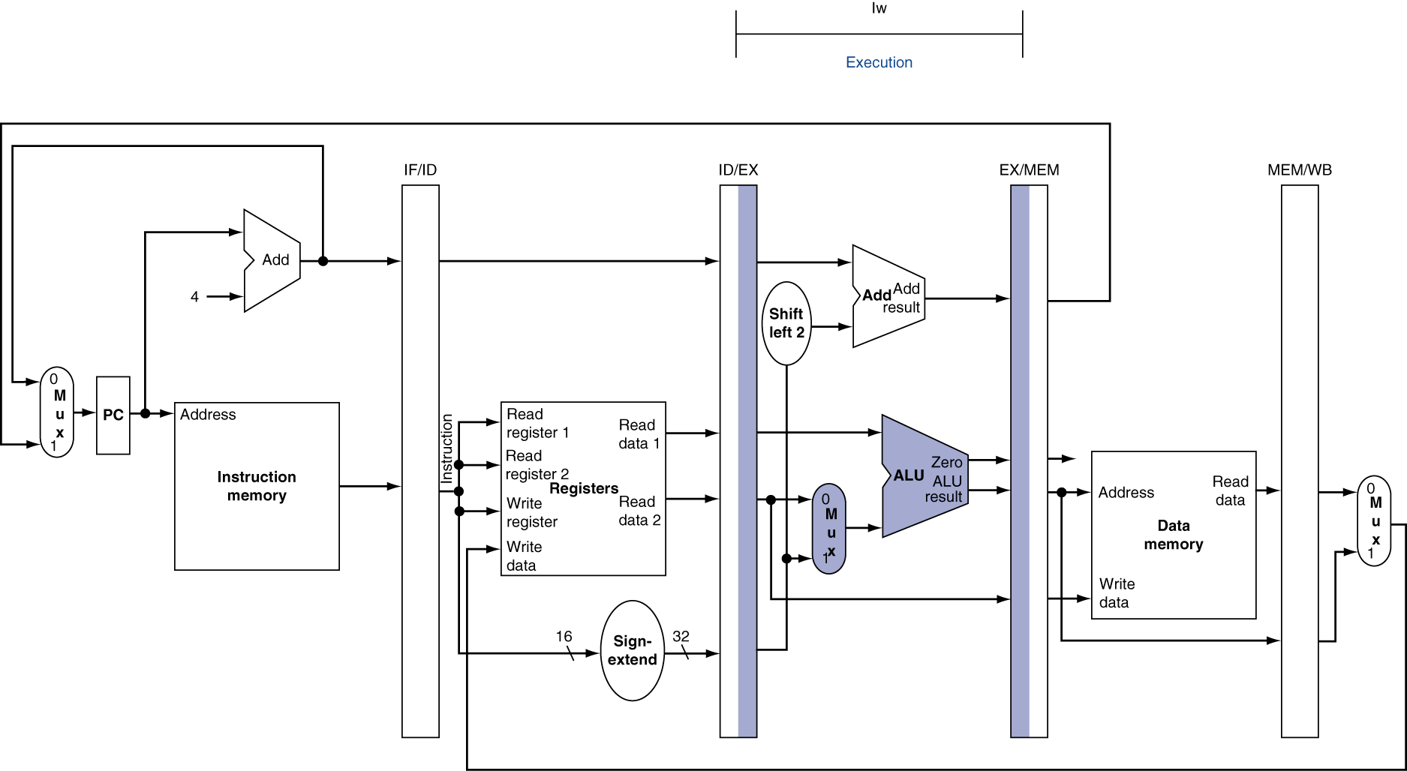
EX for Load

Slide 63
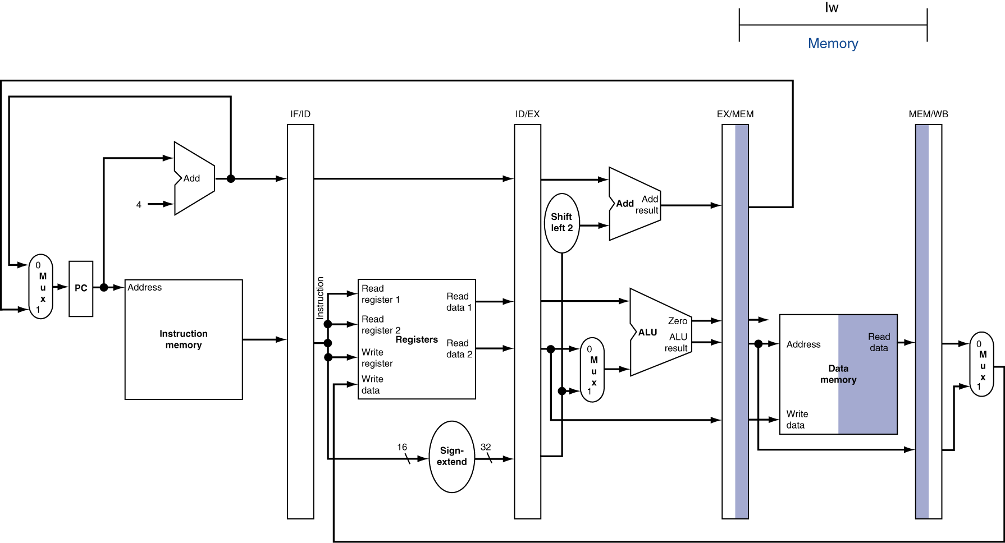
MEM for Load

Slide 64
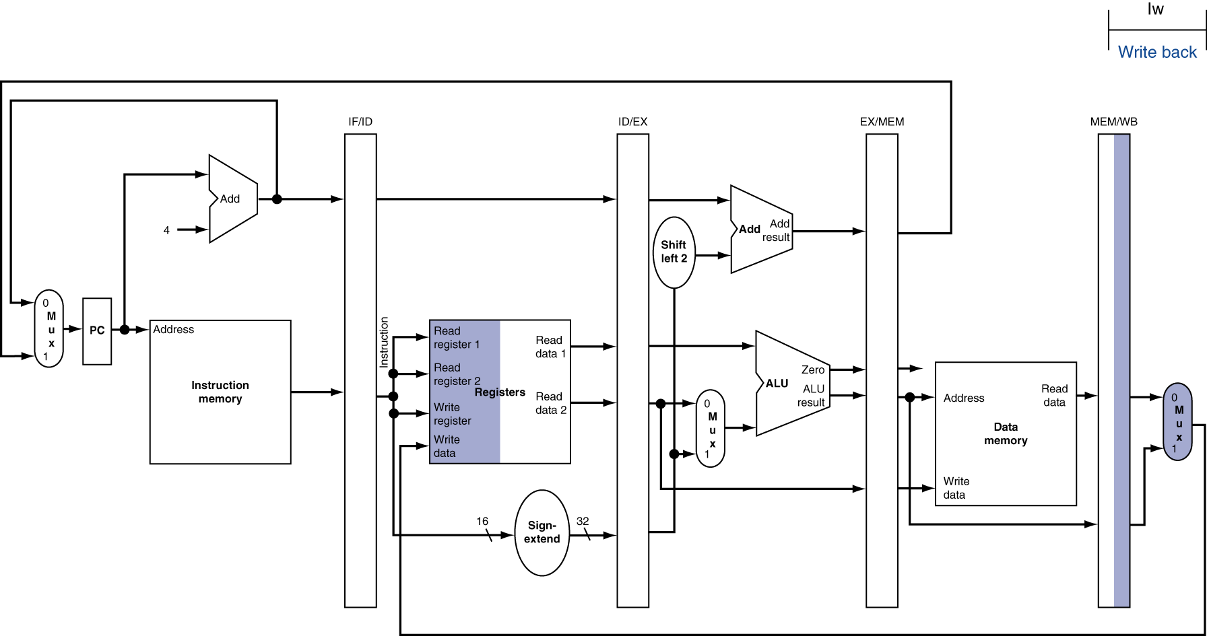
WB for Load
Wrong register number

Slide 65
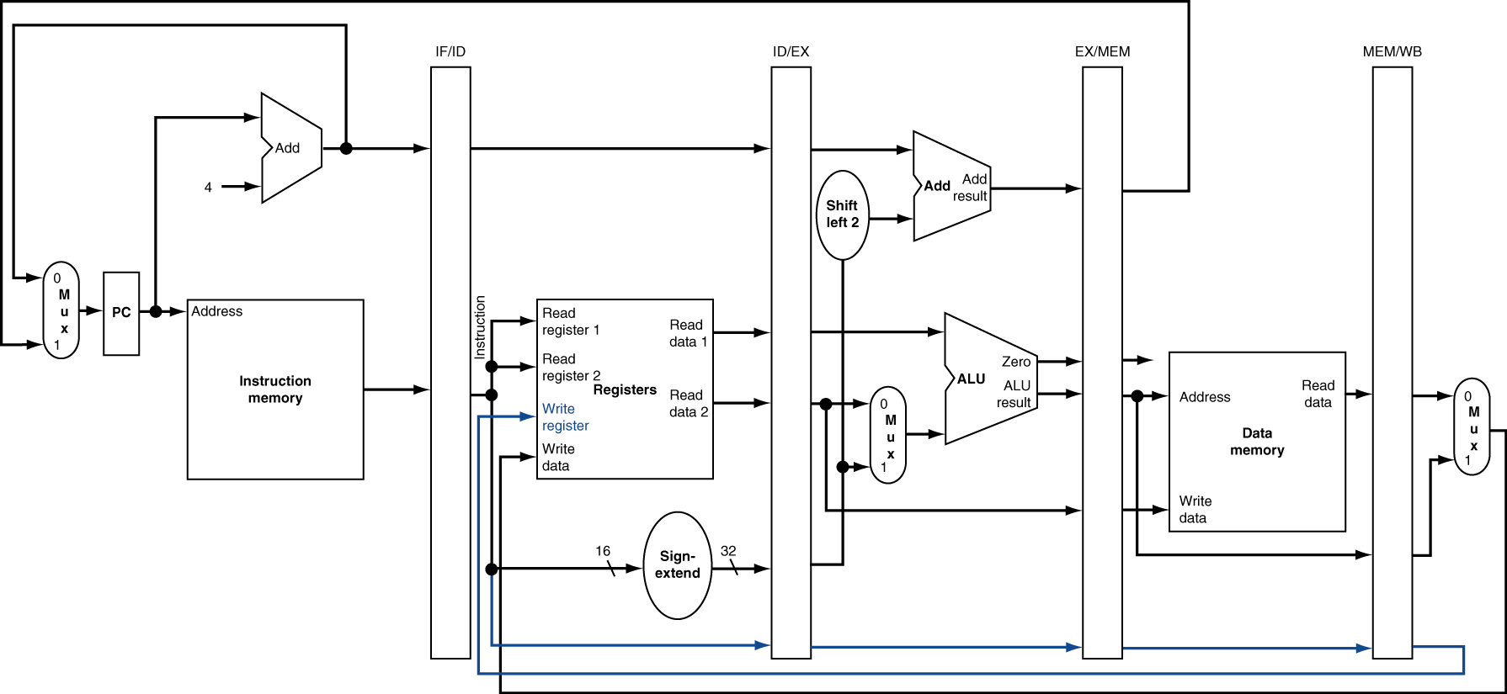
Corrected Datapath for Load

Slide 66

EX for Store

Slide 67
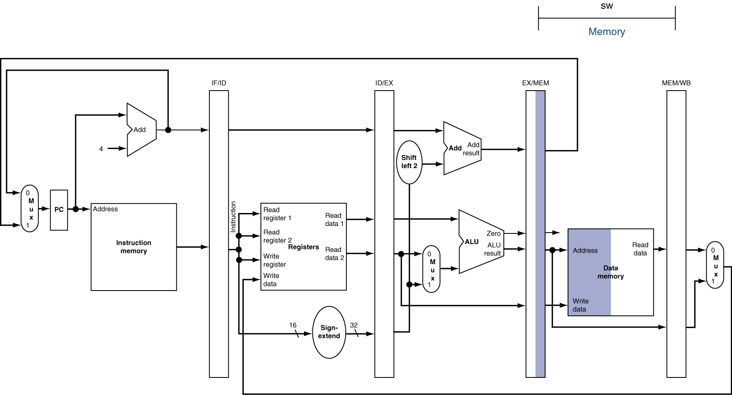
MEM for Store

Slide 68
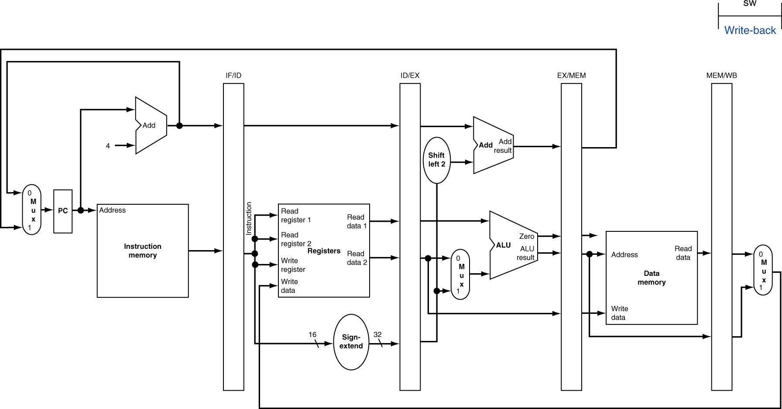
WB for Store

Slide 69
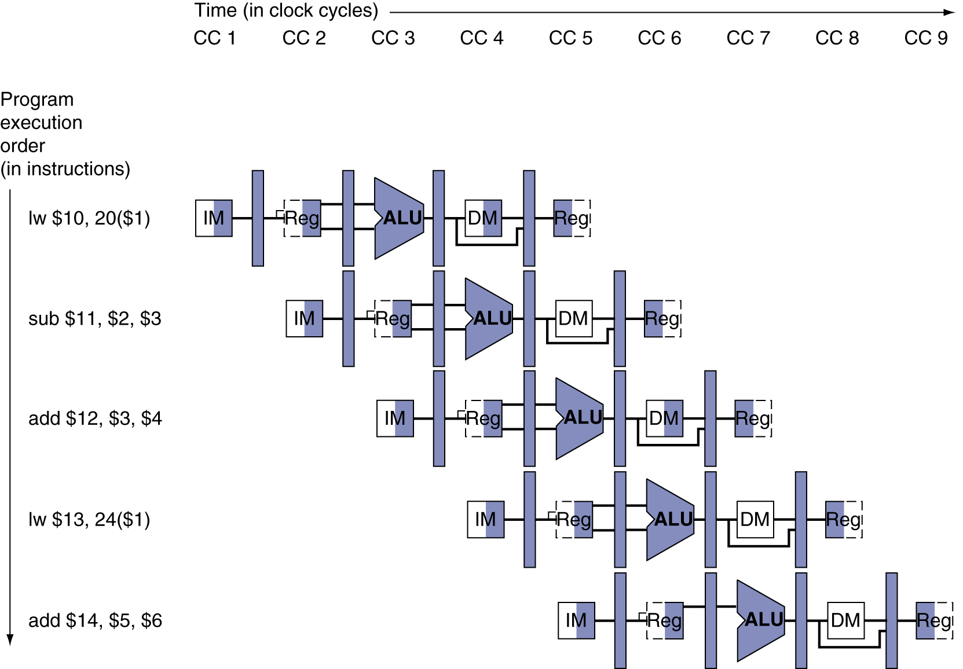
Multi-Cycle Pipeline Diagram
Form showing resource usage

Slide 70
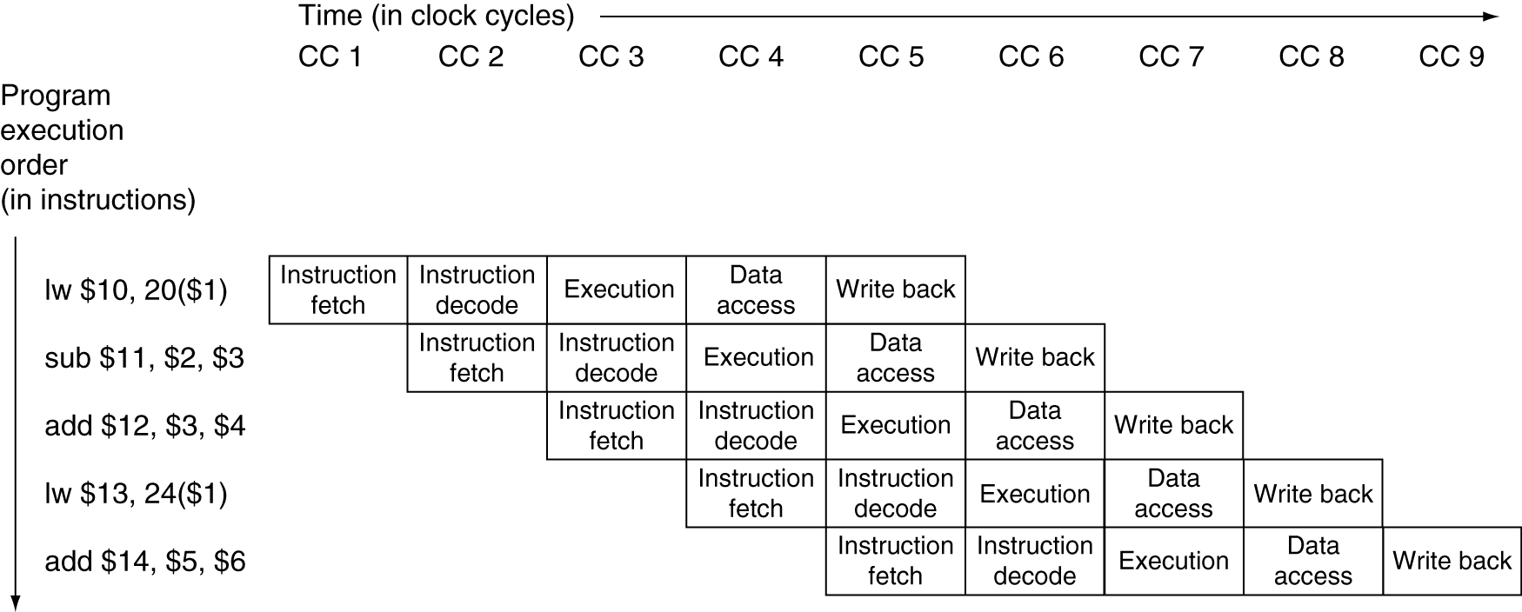
Multi-Cycle Pipeline Diagram
Traditional form

Slide 71
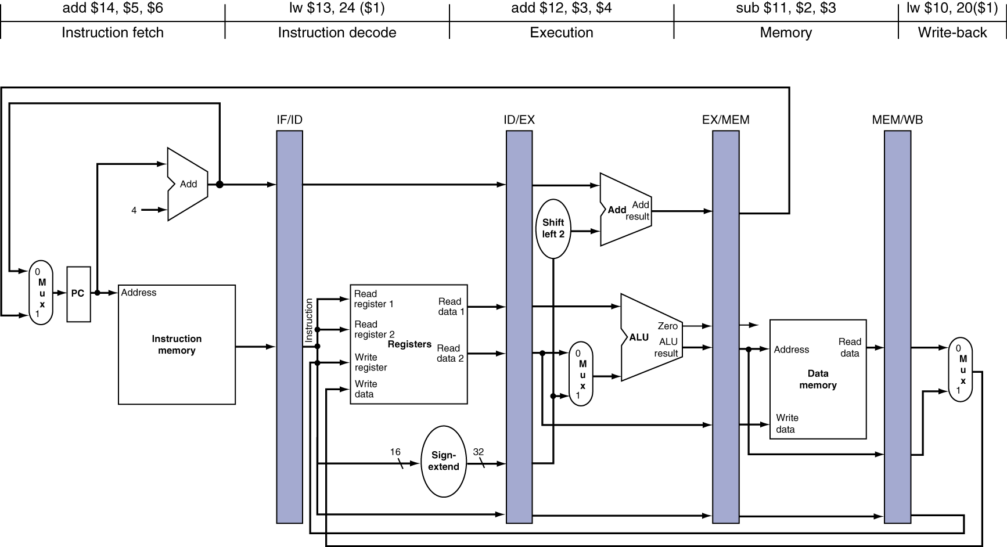
Single-Cycle Pipeline Diagram
State of pipeline in a given cycle

Slide 72
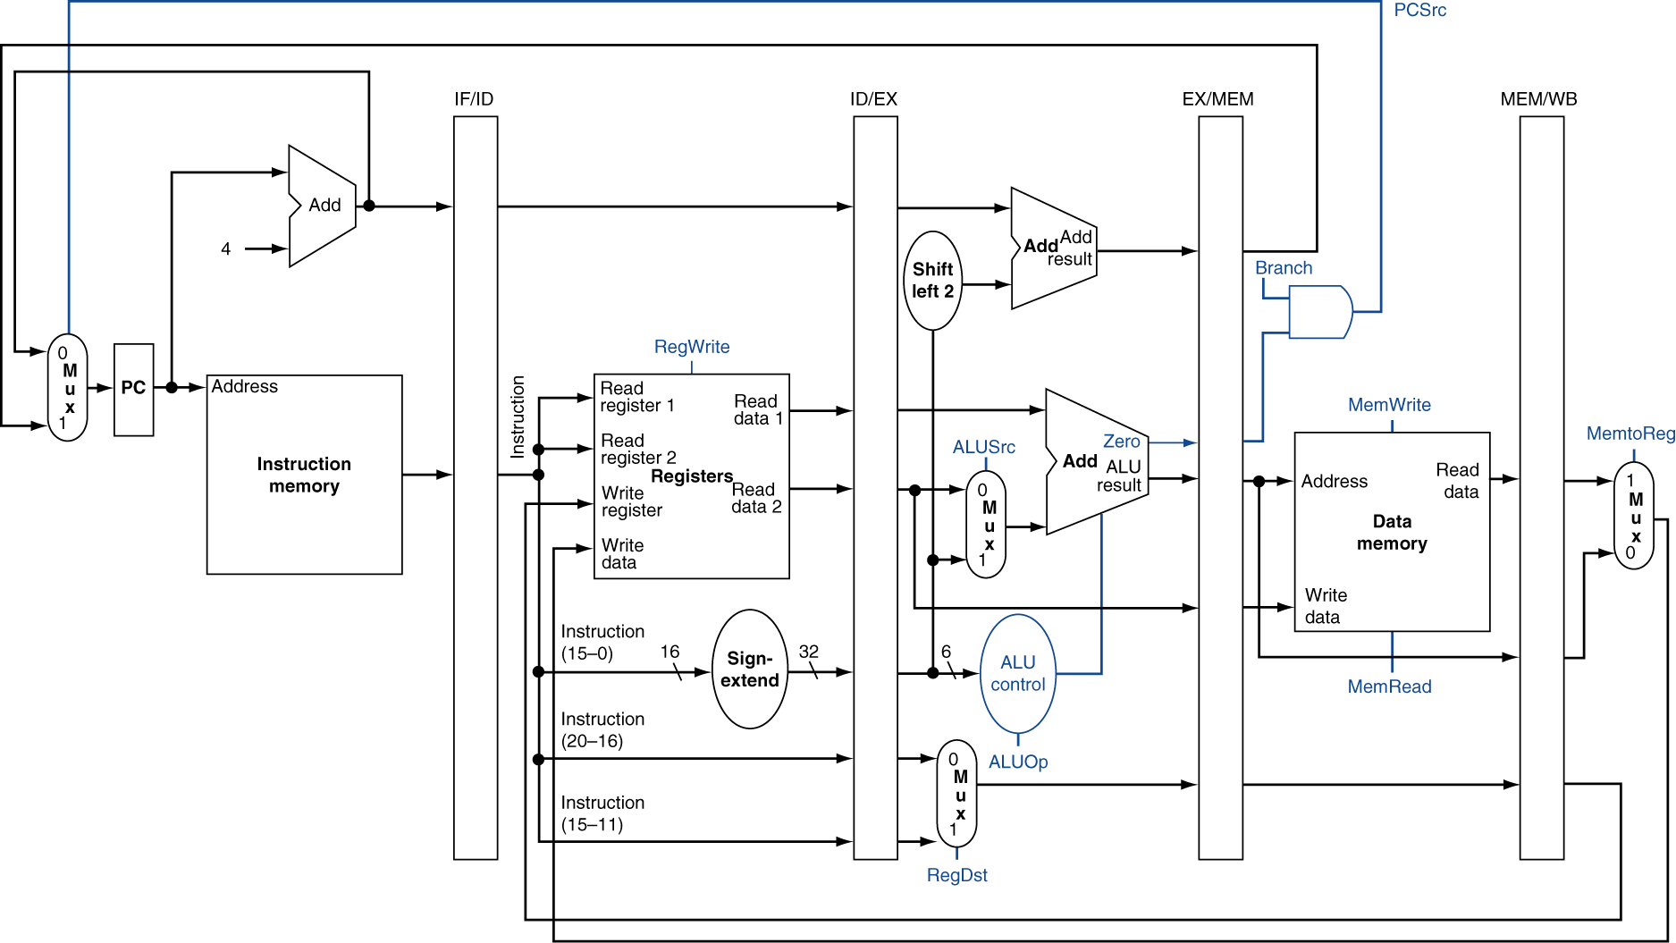
Pipelined Control (Simplified)

Slide 73
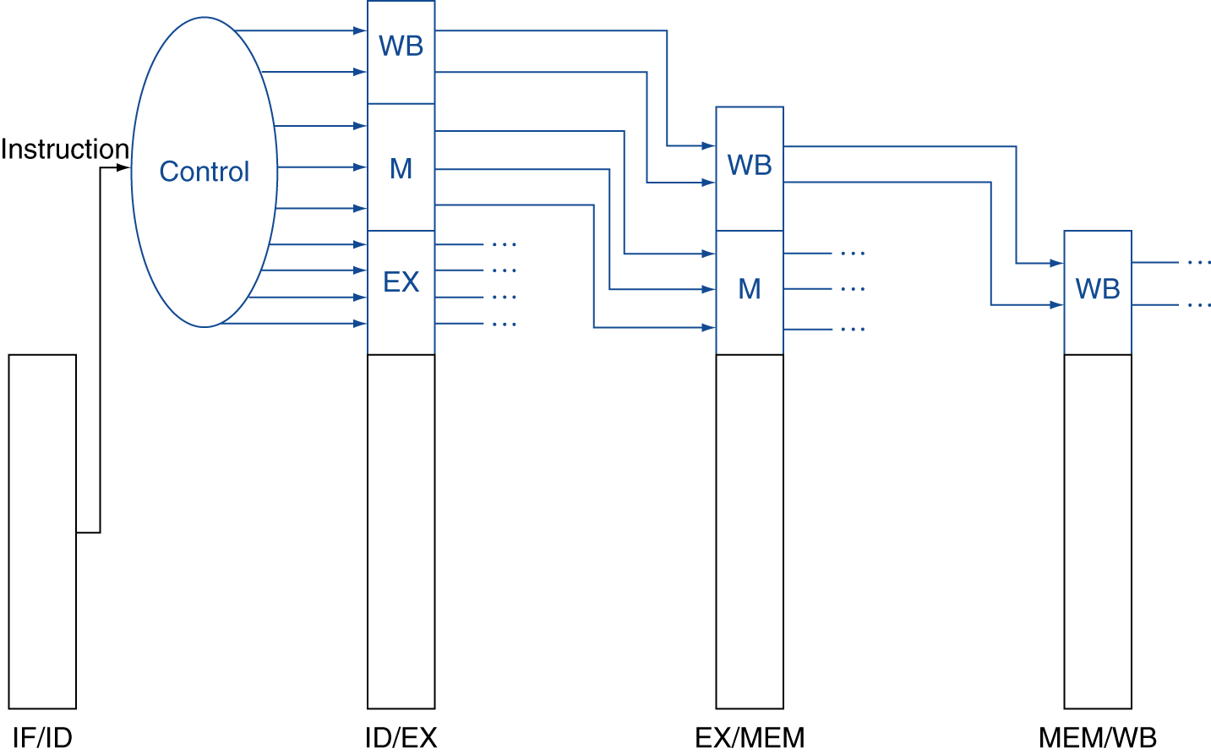
Pipelined Control
Control signals derived from instruction
As in single-cycle implementation

Slide 74
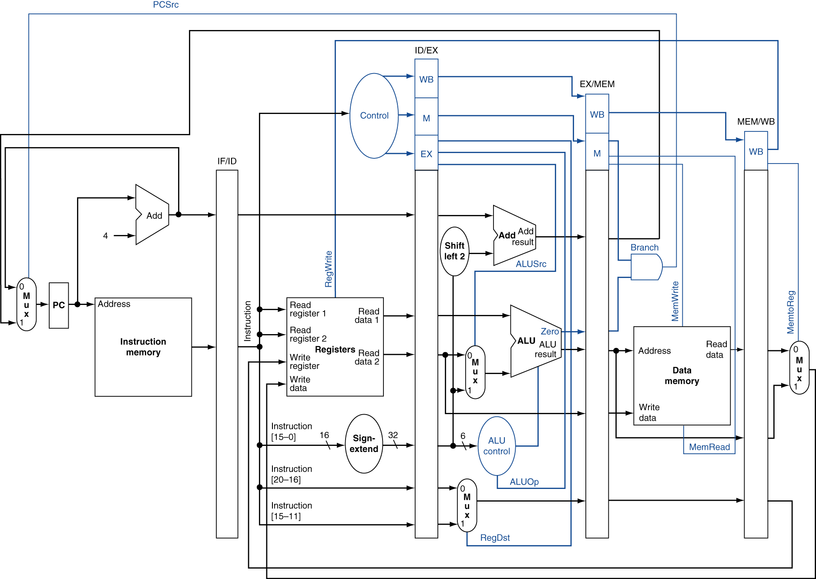
Pipelined Control

Slide 75
Data Hazards in ALU Instructions
Consider this sequence:
sub $2, $1,$3 and $12,$2,$5 or $13,$6,$2 add $14,$2,$2 sw $15,100($2)
We can resolve hazards with forwarding
How do we detect when to forward?
§4.7 Data Hazards: Forwarding vs. Stalling

Slide 76
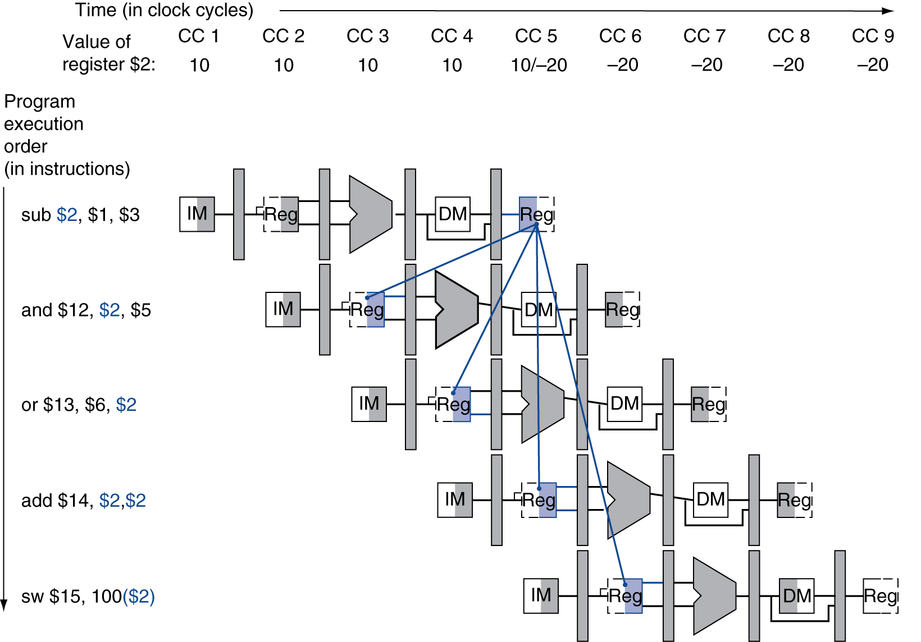
Dependencies & Forwarding

Slide 77
Detecting the Need to Forward
Pass register numbers along pipeline
e.g., ID/EX.RegisterRs = register number for Rs sitting in ID/EX pipeline register
ALU operand register numbers in EX stage are given by
ID/EX.RegisterRs, ID/EX.RegisterRt
Data hazards when
1a. EX/MEM.RegisterRd = ID/EX.RegisterRs
1b. EX/MEM.RegisterRd = ID/EX.RegisterRt
2a. MEM/WB.RegisterRd = ID/EX.RegisterRs
2b. MEM/WB.RegisterRd = ID/EX.RegisterRt
Fwd from EX/MEM pipeline reg
Fwd from MEM/WB pipeline reg

Slide 78
Detecting the Need to Forward
But only if forwarding instruction will write to a register!
EX/MEM.RegWrite, MEM/WB.RegWrite
And only if Rd for that instruction is not $zero
EX/MEM.RegisterRd ≠ 0, MEM/WB.RegisterRd ≠ 0

Slide 79
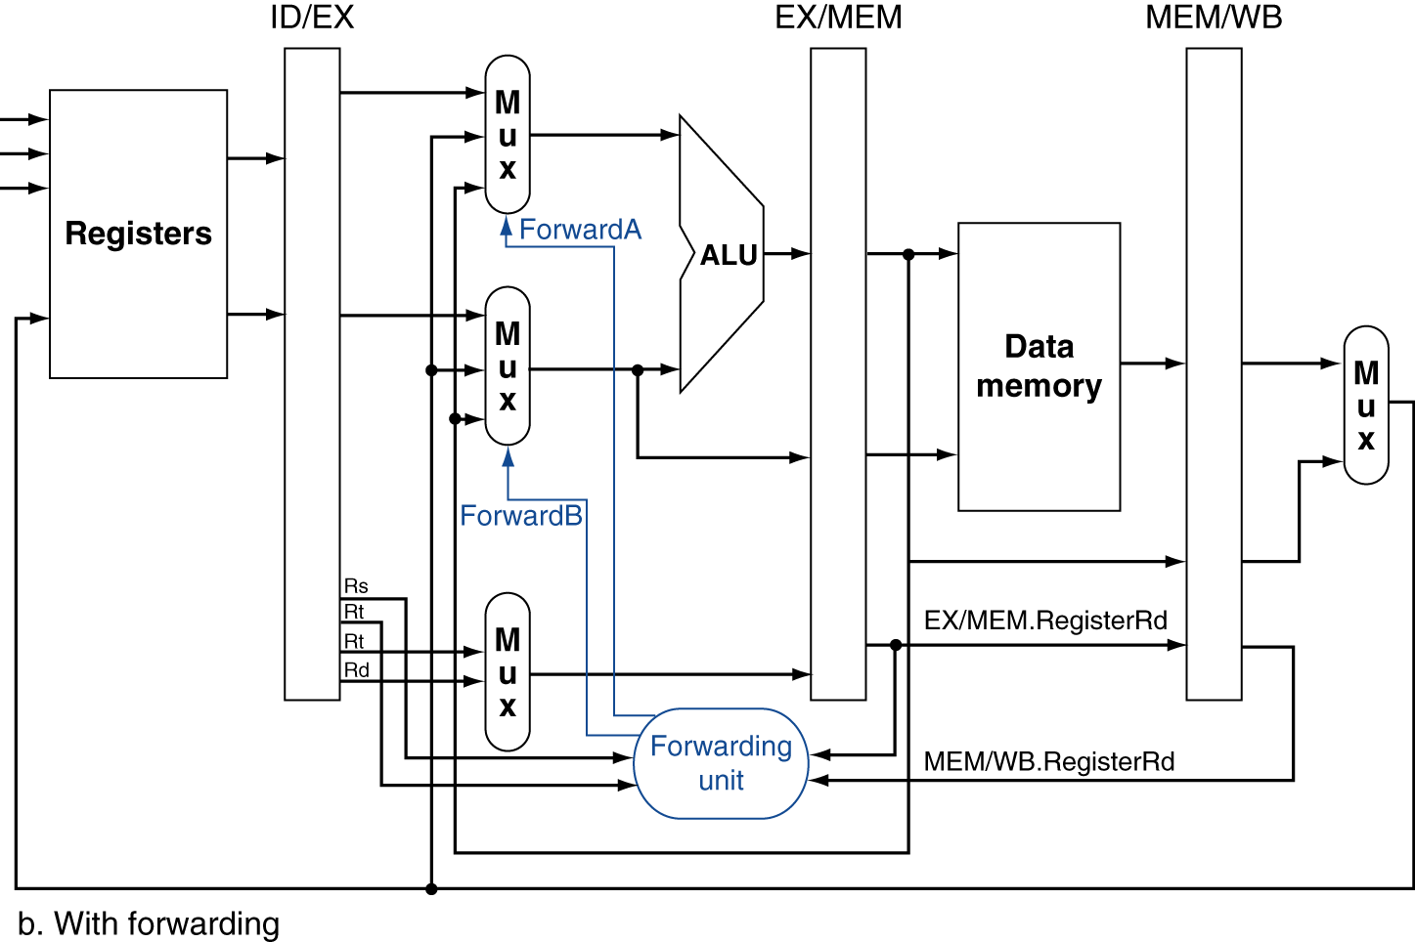
Forwarding Paths

Slide 80
Forwarding Conditions
EX hazard
if (EX/MEM.RegWrite and (EX/MEM.RegisterRd ≠ 0) and (EX/MEM.RegisterRd = ID/EX.RegisterRs)) ForwardA = 10
if (EX/MEM.RegWrite and (EX/MEM.RegisterRd ≠ 0) and (EX/MEM.RegisterRd = ID/EX.RegisterRt)) ForwardB = 10
MEM hazard
if (MEM/WB.RegWrite and (MEM/WB.RegisterRd ≠ 0) and (MEM/WB.RegisterRd = ID/EX.RegisterRs)) ForwardA = 01
if (MEM/WB.RegWrite and (MEM/WB.RegisterRd ≠ 0) and (MEM/WB.RegisterRd = ID/EX.RegisterRt)) ForwardB = 01

Slide 81
Double Data Hazard
Consider the sequence:
add $1,$1,$2 add $1,$1,$3 add $1,$1,$4
Both hazards occur
Want to use the most recent
Revise MEM hazard condition
Only fwd if EX hazard condition isn’t true

Slide 82
Revised Forwarding Condition
MEM hazard
if (MEM/WB.RegWrite and (MEM/WB.RegisterRd ≠ 0) and not (EX/MEM.RegWrite and (EX/MEM.RegisterRd ≠ 0) and (EX/MEM.RegisterRd = ID/EX.RegisterRs)) and (MEM/WB.RegisterRd = ID/EX.RegisterRs)) ForwardA = 01
if (MEM/WB.RegWrite and (MEM/WB.RegisterRd ≠ 0) and not (EX/MEM.RegWrite and (EX/MEM.RegisterRd ≠ 0) and (EX/MEM.RegisterRd = ID/EX.RegisterRt)) and (MEM/WB.RegisterRd = ID/EX.RegisterRt)) ForwardB = 01

Slide 83
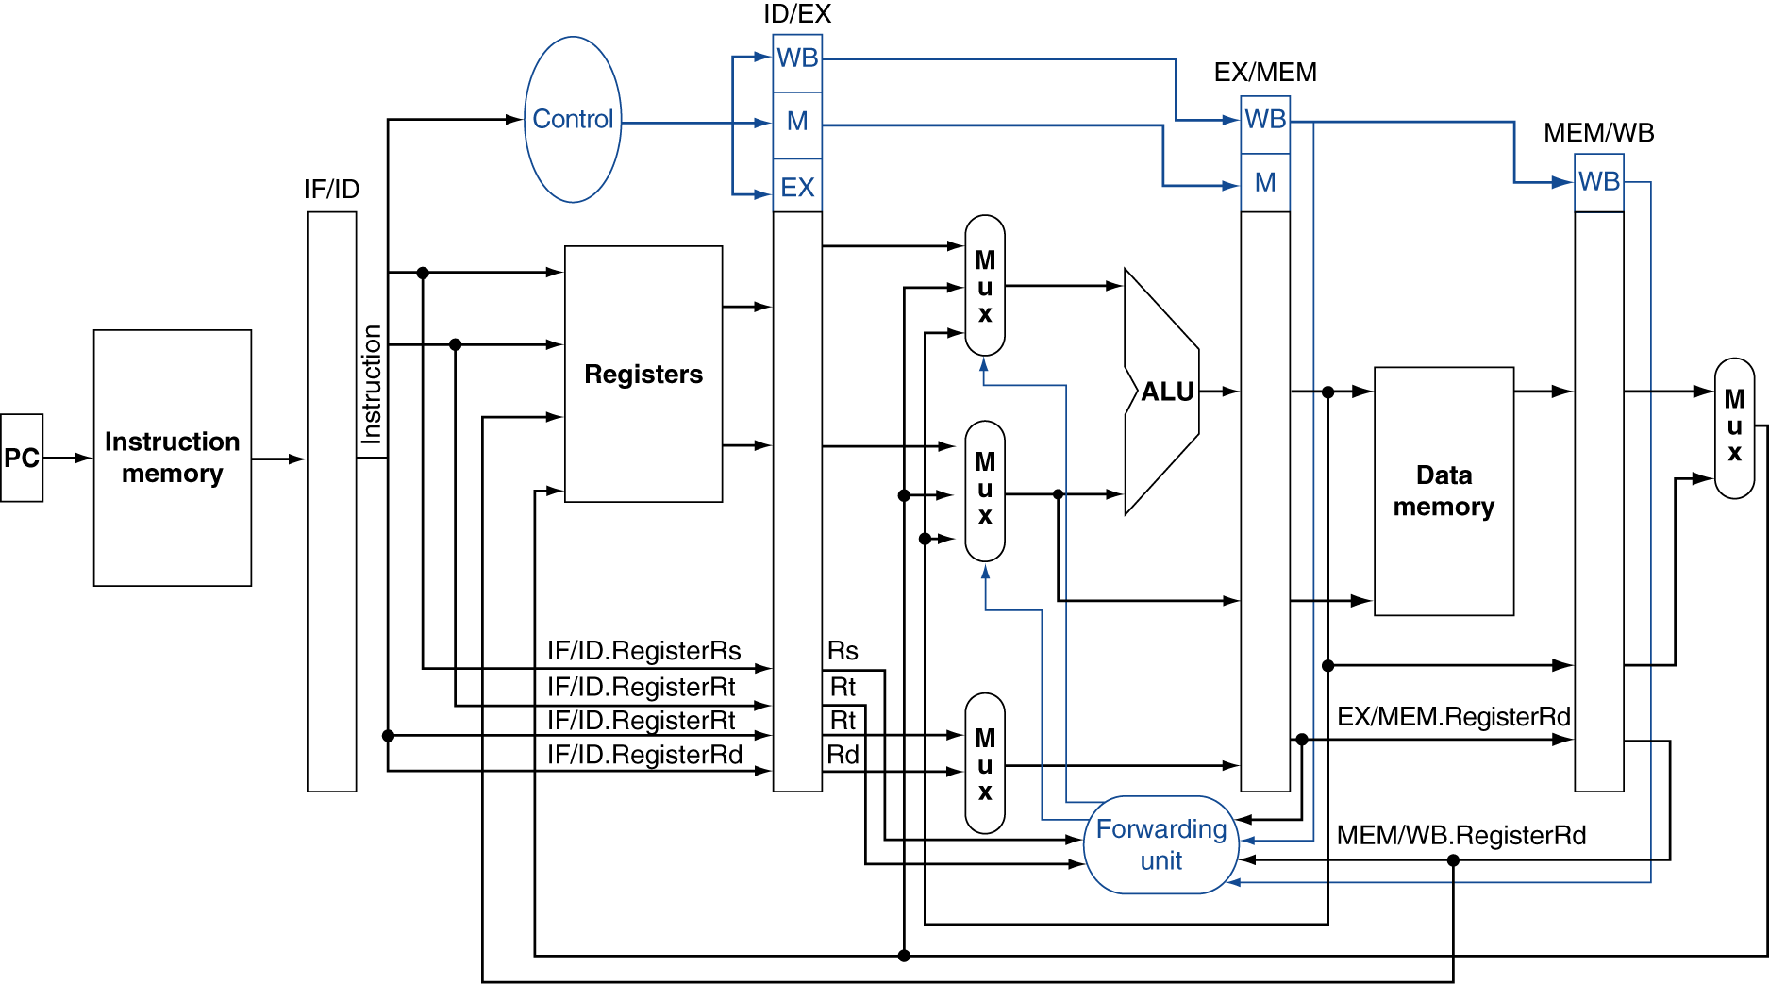
Datapath with Forwarding

Slide 84
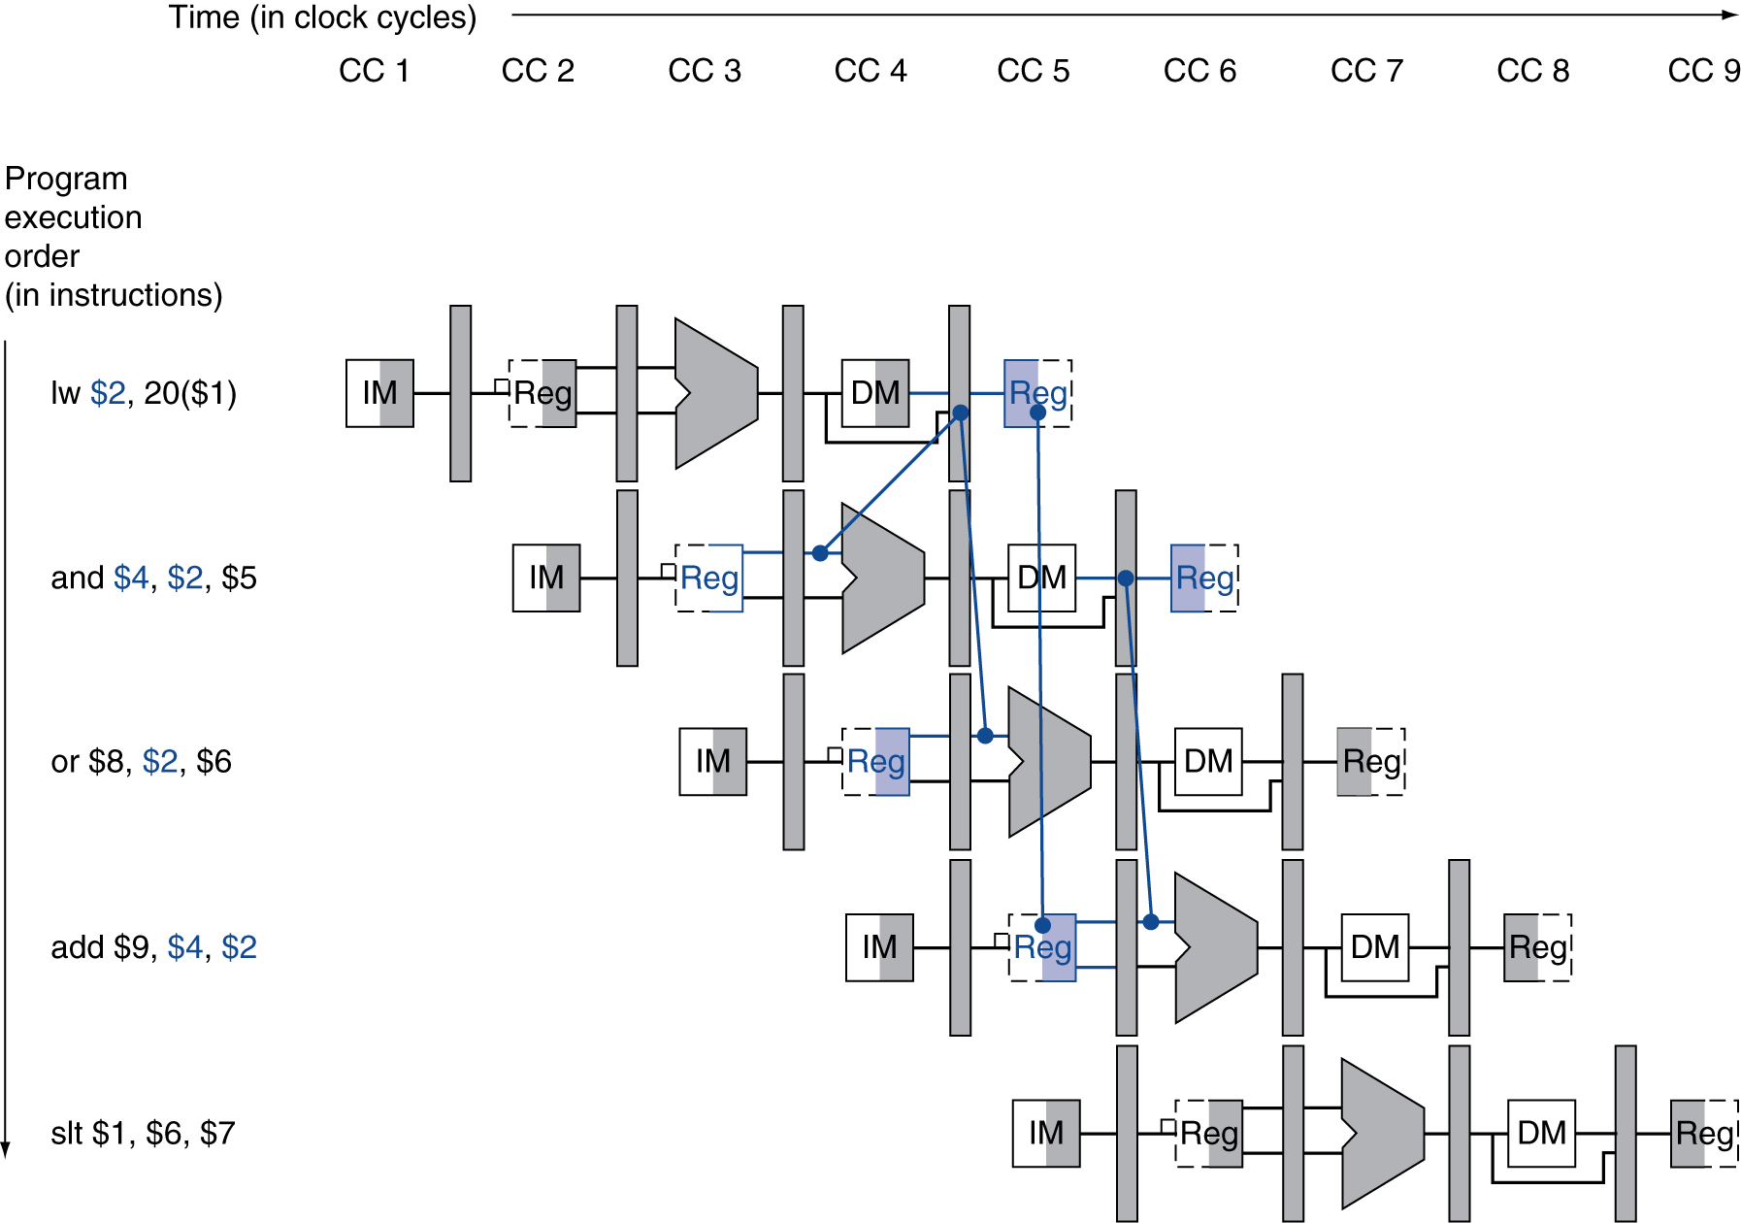
Load-Use Data Hazard
Need to stall for one cycle

Slide 85
Load-Use Hazard Detection
Check when using instruction is decoded in ID stage
ALU operand register numbers in ID stage are given by
IF/ID.RegisterRs, IF/ID.RegisterRt
Load-use hazard when
ID/EX.MemRead and ((ID/EX.RegisterRt = IF/ID.RegisterRs) or (ID/EX.RegisterRt = IF/ID.RegisterRt))
If detected, stall and insert bubble

Slide 86
How to Stall the Pipeline
Force control values in ID/EX register to 0
EX, MEM and WB do nop (no-operation)
Prevent update of PC and IF/ID register
Using instruction is decoded again
Following instruction is fetched again
1-cycle stall allows MEM to read data for lw
Can subsequently forward to EX stage

Slide 87

Stall/Bubble in the Pipeline
Stall inserted here

Slide 88

Stall/Bubble in the Pipeline
Or, more accurately…

Slide 89

Datapath with Hazard Detection

Slide 90
Stalls and Performance
The BIG Picture
Stalls reduce performance
But are required to get correct results
Compiler can arrange code to avoid hazards and stalls
Requires knowledge of the pipeline structure

Slide 91

Branch Hazards
§4.8 Control Hazards
If branch outcome determined in MEM
Flush these instructions
(Set control values to 0)
PC

Slide 92
Reducing Branch Delay
Move hardware to determine outcome to ID stage
Target address adder
Register comparator
Example: branch taken
36: sub $10, $4, $8 40: beq $1, $3, 7 44: and $12, $2, $5 48: or $13, $2, $6 52: add $14, $4, $2 56: slt $15, $6, $7 ... 72: lw $4, 50($7)

Slide 93

Example: Branch Taken

Slide 94

Example: Branch Taken

Slide 95
Data Hazards for Branches
If a comparison register is a destination of 2nd or 3rd preceding ALU instruction
add $1, $2, $3
IF
ID
EX
MEM
WB
add $4, $5, $6
IF
ID
EX
MEM
WB
…
IF
ID
EX
MEM
WB
beq $1, $4, target
IF
ID
EX
MEM
WB
Can resolve using forwarding

Slide 96
Data Hazards for Branches
If a comparison register is a destination of preceding ALU instruction or 2nd preceding load instruction
Need 1 stall cycle
lw $1, addr
IF
ID
EX
MEM
WB
add $4, $5, $6
IF
ID
EX
MEM
WB
beq stalled
IF
ID
beq $1, $4, target
ID
EX
MEM
WB

Slide 97
Data Hazards for Branches
If a comparison register is a destination of immediately preceding load instruction
Need 2 stall cycles
lw $1, addr
IF
ID
EX
MEM
WB
beq stalled
IF
ID
beq stalled
ID
beq $1, $0, target
ID
EX
MEM
WB

Slide 98
Dynamic Branch Prediction
In deeper and superscalar pipelines, branch penalty is more significant
Use dynamic prediction
Branch prediction buffer (aka branch history table)
Indexed by recent branch instruction addresses
Stores outcome (taken/not taken)
To execute a branch
Check table, expect the same outcome
Start fetching from fall-through or target
If wrong, flush pipeline and flip prediction

Slide 99
1-Bit Predictor: Shortcoming
Inner loop branches mispredicted twice!
outer: … … inner: …
…
beq …, …, inner … beq …, …, outer
Mispredict as taken on last iteration of inner loop
Then mispredict as not taken on first iteration of inner loop next time around

Slide 100

2-Bit Predictor
Only change prediction on two successive mispredictions

Slide 101
Calculating the Branch Target
Even with predictor, still need to calculate the target address
1-cycle penalty for a taken branch
Branch target buffer
Cache of target addresses
Indexed by PC when instruction fetched
If hit and instruction is branch predicted taken, can fetch target immediately

Slide 102
Exceptions and Interrupts
§4.9 Exceptions
“Unexpected” events requiring change in flow of control
Different ISAs use the terms differently
Exception
Arises within the CPU
e.g., undefined opcode, overflow, syscall, …
Interrupt
From an external I/O controller
Dealing with them without sacrificing performance is hard

Slide 103
Handling Exceptions
In MIPS, exceptions managed by a System Control Coprocessor (CP0)
Save PC of offending (or interrupted) instruction
In MIPS: Exception Program Counter (EPC)
Save indication of the problem
In MIPS: Cause register
We’ll assume 1-bit
0 for undefined opcode, 1 for overflow
Jump to handler at 8000 00180

Slide 104
An Alternate Mechanism
Vectored Interrupts
Handler address determined by the cause
Example:
Undefined opcode: C000 0000
Overflow: C000 0020
…: C000 0040
Instructions either
Deal with the interrupt, or
Jump to real handler

Slide 105
Handler Actions
Read cause, and transfer to relevant handler
Determine action required
If restartable
Take corrective action
use EPC to return to program
Otherwise
Terminate program
Report error using EPC, cause, …

Slide 106
Exceptions in a Pipeline
Another form of control hazard
Consider overflow on add in EX stage
add $1, $2, $1
Prevent $1 from being clobbered
Complete previous instructions
Flush add and subsequent instructions
Set Cause and EPC register values
Transfer control to handler
Similar to mispredicted branch
Use much of the same hardware

Slide 107

Pipeline with Exceptions

Slide 108
Exception Properties
Restartable exceptions
Pipeline can flush the instruction
Handler executes, then returns to the instruction
Refetched and executed from scratch
PC saved in EPC register
Identifies causing instruction
Actually PC + 4 is saved
Handler must adjust

Slide 109
Exception Example
Exception on add in
40 sub $11, $2, $4 44 and $12, $2, $5 48 or $13, $2, $6 4C add $1, $2, $1 50 slt $15, $6, $7 54 lw $16, 50($7) …
Handler
80000180 sw $25, 1000($0) 80000184 sw $26, 1004($0) …

Slide 110

Exception Example

Slide 111

Exception Example

Slide 112
Multiple Exceptions
Pipelining overlaps multiple instructions
Could have multiple exceptions at once
Simple approach: deal with exception from earliest instruction
Flush subsequent instructions
“Precise” exceptions
In complex pipelines
Multiple instructions issued per cycle
Out-of-order completion
Maintaining precise exceptions is difficult!

Slide 113
Imprecise Exceptions
Just stop pipeline and save state
Including exception cause(s)
Let the handler work out
Which instruction(s) had exceptions
Which to complete or flush
May require “manual” completion
Simplifies hardware, but more complex handler software
Not feasible for complex multiple-issue out-of-order pipelines

Slide 114
Instruction-Level Parallelism (ILP)
Pipelining: executing multiple instructions in parallel
To increase ILP
Deeper pipeline
Less work per stage ⇒ shorter clock cycle
Multiple issue
Replicate pipeline stages ⇒ multiple pipelines
Start multiple instructions per clock cycle
CPI < 1, so use Instructions Per Cycle (IPC)
E.g., 4GHz 4-way multiple-issue
16 BIPS, peak CPI = 0.25, peak IPC = 4
But dependencies reduce this in practice
§4.10 Parallelism via Instructions

Slide 115
Multiple Issue
Static multiple issue
Compiler groups instructions to be issued together
Packages them into “issue slots”
Compiler detects and avoids hazards
Dynamic multiple issue
CPU examines instruction stream and chooses instructions to issue each cycle
Compiler can help by reordering instructions
CPU resolves hazards using advanced techniques at runtime

Slide 116
Speculation
“Guess” what to do with an instruction
Start operation as soon as possible
Check whether guess was right
If so, complete the operation
If not, roll-back and do the right thing
Common to static and dynamic multiple issue
Examples
Speculate on branch outcome
Roll back if path taken is different
Speculate on load
Roll back if location is updated

Slide 117
Compiler/Hardware Speculation
Compiler can reorder instructions
e.g., move load before branch
Can include “fix-up” instructions to recover from incorrect guess
Hardware can look ahead for instructions to execute
Buffer results until it determines they are actually needed
Flush buffers on incorrect speculation

Slide 118
Speculation and Exceptions
What if exception occurs on a speculatively executed instruction?
e.g., speculative load before null-pointer check
Static speculation
Can add ISA support for deferring exceptions
Dynamic speculation
Can buffer exceptions until instruction completion (which may not occur)

Slide 119
Static Multiple Issue
Compiler groups instructions into “issue packets”
Group of instructions that can be issued on a single cycle
Determined by pipeline resources required
Think of an issue packet as a very long instruction
Specifies multiple concurrent operations
⇒ Very Long Instruction Word (VLIW)

Slide 120
Scheduling Static Multiple Issue
Compiler must remove some/all hazards
Reorder instructions into issue packets
No dependencies with a packet
Possibly some dependencies between packets
Varies between ISAs; compiler must know!
Pad with nop if necessary

Slide 121
MIPS with Static Dual Issue
Two-issue packets
One ALU/branch instruction
One load/store instruction
64-bit aligned
ALU/branch, then load/store
Pad an unused instruction with nop
Address | Instruction type | Pipeline Stages
n | ALU/branch | IF | ID | EX | MEM | WB
n + 4 | Load/store | IF | ID | EX | MEM | WB
n + 8 | ALU/branch |  | IF | ID | EX | MEM | WB
n + 12 | Load/store |  | IF | ID | EX | MEM | WB
n + 16 | ALU/branch |  |  | IF | ID | EX | MEM | WB
n + 20 | Load/store |  |  | IF | ID | EX | MEM | WB

Slide 122

MIPS with Static Dual Issue

Slide 123
Hazards in the Dual-Issue MIPS
More instructions executing in parallel
EX data hazard
Forwarding avoided stalls with single-issue
Now can’t use ALU result in load/store in same packet
add $t0, $s0, $s1 load $s2, 0($t0)
Split into two packets, effectively a stall
Load-use hazard
Still one cycle use latency, but now two instructions
More aggressive scheduling required

Slide 124
Scheduling Example
Schedule this for dual-issue MIPS
Loop: lw $t0, 0($s1) # $t0=array element addu $t0, $t0, $s2 # add scalar in $s2 sw $t0, 0($s1) # store result addi $s1, $s1,–4 # decrement pointer bne $s1, $zero, Loop # branch $s1!=0
 | ALU/branch | Load/store | cycle
Loop: | nop | lw $t0, 0($s1) | 1
 | addi $s1, $s1,–4 | nop | 2
 | addu $t0, $t0, $s2 | nop | 3
 | bne $s1, $zero, Loop | sw $t0, 4($s1) | 4
IPC = 5/4 = 1.25 (c.f. peak IPC = 2)

Slide 125
Loop Unrolling
Replicate loop body to expose more parallelism
Reduces loop-control overhead
Use different registers per replication
Called “register renaming”
Avoid loop-carried “anti-dependencies”
Store followed by a load of the same register
Aka “name dependence”
Reuse of a register name

Slide 126
Loop Unrolling Example
 | ALU/branch | Load/store | cycle
Loop: | addi $s1, $s1,–16 | lw $t0, 0($s1) | 1
 | nop | lw $t1, 12($s1) | 2
 | addu $t0, $t0, $s2 | lw $t2, 8($s1) | 3
 | addu $t1, $t1, $s2 | lw $t3, 4($s1) | 4
 | addu $t2, $t2, $s2 | sw $t0, 16($s1) | 5
 | addu $t3, $t4, $s2 | sw $t1, 12($s1) | 6
 | nop | sw $t2, 8($s1) | 7
 | bne $s1, $zero, Loop | sw $t3, 4($s1) | 8
IPC = 14/8 = 1.75
Closer to 2, but at cost of registers and code size

Slide 127
Dynamic Multiple Issue
“Superscalar” processors
CPU decides whether to issue 0, 1, 2, … each cycle
Avoiding structural and data hazards
Avoids the need for compiler scheduling
Though it may still help
Code semantics ensured by the CPU

Slide 128
Dynamic Pipeline Scheduling
Allow the CPU to execute instructions out of order to avoid stalls
But commit result to registers in order
Example
lw $t0, 20($s2) addu $t1, $t0, $t2 sub $s4, $s4, $t3 slti $t5, $s4, 20
Can start sub while addu is waiting for lw

Slide 129

Dynamically Scheduled CPU
Preserves dependencies
Hold pending operands
Results also sent to any waiting reservation stations
Reorders buffer for register writes
Can supply operands for issued instructions

Slide 130
Register Renaming
Reservation stations and reorder buffer effectively provide register renaming
On instruction issue to reservation station
If operand is available in register file or reorder buffer
Copied to reservation station
No longer required in the register; can be overwritten
If operand is not yet available
It will be provided to the reservation station by a function unit
Register update may not be required

Slide 131
Speculation
Predict branch and continue issuing
Don’t commit until branch outcome determined
Load speculation
Avoid load and cache miss delay
Predict the effective address
Predict loaded value
Load before completing outstanding stores
Bypass stored values to load unit
Don’t commit load until speculation cleared

Slide 132
Why Do Dynamic Scheduling?
Why not just let the compiler schedule code?
Not all stalls are predicable
e.g., cache misses
Can’t always schedule around branches
Branch outcome is dynamically determined
Different implementations of an ISA have different latencies and hazards

Slide 133
Sri addition
The fact that different implementations of ISA’s have different latencies and hazards is why making emulators for old game consoles is so hard
People who have optimized timing and data for a specific known set of instruction timings and then everything breaks when that isn’t the case.

Slide 134
Does Multiple Issue Work?
The BIG Picture
Yes, but not as much as we’d like
Programs have real dependencies that limit ILP
Some dependencies are hard to eliminate
e.g., pointer aliasing
Some parallelism is hard to expose
Limited window size during instruction issue
Memory delays and limited bandwidth
Hard to keep pipelines full
Speculation can help if done well

Slide 135
Power Efficiency
Complexity of dynamic scheduling and speculations requires power
Multiple simpler cores may be better
Microprocessor | Year | Clock Rate | Pipeline Stages | Issue width | Out-of-order/ Speculation | Cores | Power
i486 | 1989 | 25MHz | 5 | 1 | No | 1 | 5W
Pentium | 1993 | 66MHz | 5 | 2 | No | 1 | 10W
Pentium Pro | 1997 | 200MHz | 10 | 3 | Yes | 1 | 29W
P4 Willamette | 2001 | 2000MHz | 22 | 3 | Yes | 1 | 75W
P4 Prescott | 2004 | 3600MHz | 31 | 3 | Yes | 1 | 103W
Core | 2006 | 2930MHz | 14 | 4 | Yes | 2 | 75W
UltraSparc III | 2003 | 1950MHz | 14 | 4 | No | 1 | 90W
UltraSparc T1 | 2005 | 1200MHz | 6 | 1 | No | 8 | 70W

Slide 136
Cortex A8 and Intel i7
Processor | ARM A8 | Intel Core i7 920
Market | Personal Mobile Device | Server, cloud
Thermal design power | 2 Watts | 130 Watts
Clock rate | 1 GHz | 2.66 GHz
Cores/Chip | 1 | 4
Floating point? | No | Yes
Multiple issue? | Dynamic | Dynamic
Peak instructions/clock cycle | 2 | 4
Pipeline stages | 14 | 14
Pipeline schedule | Static in-order | Dynamic out-of-order with speculation
Branch prediction | 2-level | 2-level
1st level caches/core | 32 KiB I, 32 KiB D | 32 KiB I, 32 KiB D
2nd level caches/core | 128-1024 KiB | 256 KiB
3rd level caches (shared) | - | 2- 8 MB
§4.11 Real Stuff: The ARM Cortex-A8 and Intel Core i7 Pipelines

Slide 137

ARM Cortex-A8 Pipeline

Slide 138

ARM Cortex-A8 Performance

Slide 139

Core i7 Pipeline

Slide 140


Core i7 Performance

Slide 141
Matrix Multiply
Unrolled C code
1 #include <x86intrin.h>
2 #define UNROLL (4)
3
4 void dgemm (int n, double* A, double* B, double* C)
5 {
6 for ( int i = 0; i < n; i+=UNROLL*4 )
7 for ( int j = 0; j < n; j++ ) {
8 __m256d c[4];
9 for ( int x = 0; x < UNROLL; x++ )
10 c[x] = _mm256_load_pd(C+i+x*4+j*n);
11
12 for( int k = 0; k < n; k++ )
13 {
14 __m256d b = _mm256_broadcast_sd(B+k+j*n);
15 for (int x = 0; x < UNROLL; x++)
16 c[x] = _mm256_add_pd(c[x],
17 _mm256_mul_pd(_mm256_load_pd(A+n*k+x*4+i), b));
18 }
19
20 for ( int x = 0; x < UNROLL; x++ )
21 _mm256_store_pd(C+i+x*4+j*n, c[x]);
22 }
23 }
§4.12 Instruction-Level Parallelism and Matrix Multiply

Slide 142
Matrix Multiply
Assembly code:
1 vmovapd (%r11),%ymm4 # Load 4 elements of C into %ymm4
2 mov %rbx,%rax # register %rax = %rbx
3 xor %ecx,%ecx # register %ecx = 0
4 vmovapd 0x20(%r11),%ymm3 # Load 4 elements of C into %ymm3
5 vmovapd 0x40(%r11),%ymm2 # Load 4 elements of C into %ymm2
6 vmovapd 0x60(%r11),%ymm1 # Load 4 elements of C into %ymm1
7 vbroadcastsd (%rcx,%r9,1),%ymm0 # Make 4 copies of B element
8 add $0x8,%rcx # register %rcx = %rcx + 8
9 vmulpd (%rax),%ymm0,%ymm5 # Parallel mul %ymm1,4 A elements
10 vaddpd %ymm5,%ymm4,%ymm4 # Parallel add %ymm5, %ymm4
11 vmulpd 0x20(%rax),%ymm0,%ymm5 # Parallel mul %ymm1,4 A elements
12 vaddpd %ymm5,%ymm3,%ymm3 # Parallel add %ymm5, %ymm3
13 vmulpd 0x40(%rax),%ymm0,%ymm5 # Parallel mul %ymm1,4 A elements
14 vmulpd 0x60(%rax),%ymm0,%ymm0 # Parallel mul %ymm1,4 A elements
15 add %r8,%rax # register %rax = %rax + %r8
16 cmp %r10,%rcx # compare %r8 to %rax
17 vaddpd %ymm5,%ymm2,%ymm2 # Parallel add %ymm5, %ymm2
18 vaddpd %ymm0,%ymm1,%ymm1 # Parallel add %ymm0, %ymm1
19 jne 68 <dgemm+0x68> # jump if not %r8 != %rax
20 add $0x1,%esi # register % esi = % esi + 1
21 vmovapd %ymm4,(%r11) # Store %ymm4 into 4 C elements
22 vmovapd %ymm3,0x20(%r11) # Store %ymm3 into 4 C elements
23 vmovapd %ymm2,0x40(%r11) # Store %ymm2 into 4 C elements
24 vmovapd %ymm1,0x60(%r11) # Store %ymm1 into 4 C elements
§4.12 Instruction-Level Parallelism and Matrix Multiply

Slide 143

Performance Impact

Slide 144
Fallacies
Pipelining is easy (!)
The basic idea is easy
The devil is in the details
e.g., detecting data hazards
Pipelining is independent of technology
So why haven’t we always done pipelining?
More transistors make more advanced techniques feasible
Pipeline-related ISA design needs to take account of technology trends
e.g., predicated instructions
§4.14 Fallacies and Pitfalls

Slide 145
Pitfalls
Poor ISA design can make pipelining harder
e.g., complex instruction sets (VAX, IA-32)
Significant overhead to make pipelining work
IA-32 micro-op approach
e.g., complex addressing modes
Register update side effects, memory indirection
e.g., delayed branches
Advanced pipelines have long delay slots

Slide 146
Concluding Remarks
ISA influences design of datapath and control
Datapath and control influence design of ISA
Pipelining improves instruction throughput using parallelism
More instructions completed per second
Latency for each instruction not reduced
Hazards: structural, data, control
Multiple issue and dynamic scheduling (ILP)
Dependencies limit achievable parallelism
Complexity leads to the power wall
§4.14 Concluding Remarks

